Slide 1
How Social Media Changed My Life:
The role of Twitter (X), Facebook, YouTube, etc in Pathology & Medicine
Jerad M. Gardner, MD
Dermatopathologist & Section Head of Bone/Soft Tissue Pathology
Geisinger Medical Center
Danville, Pennsylvania, USA

Slide 2
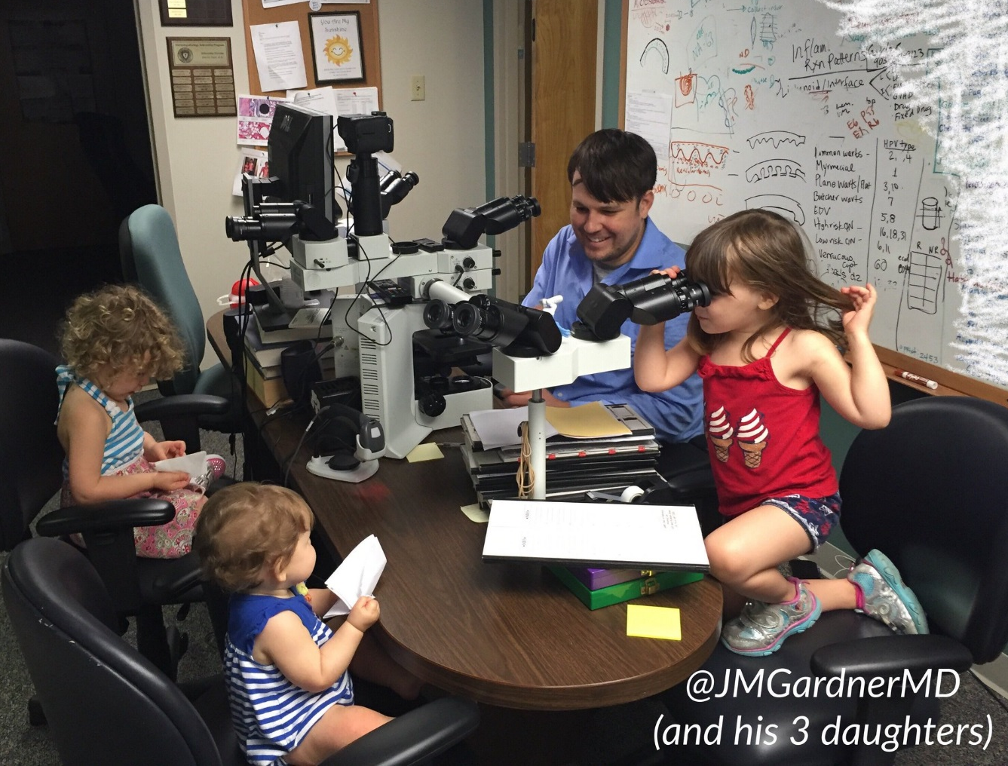
Disclosures
Revenue sharing: YouTube
Stock/Equity Ownership: Kiko, GOOG, APPL, Pathpresenter
Publishing royalties: Elsevier, Innovative Science Press
More COI details: http://bit.ly/coi-jmg
JMGardnerMD@gmail.com
Social Media 101: kikoxp.com/posts/15217
@JMGardnerMD

Slide 3
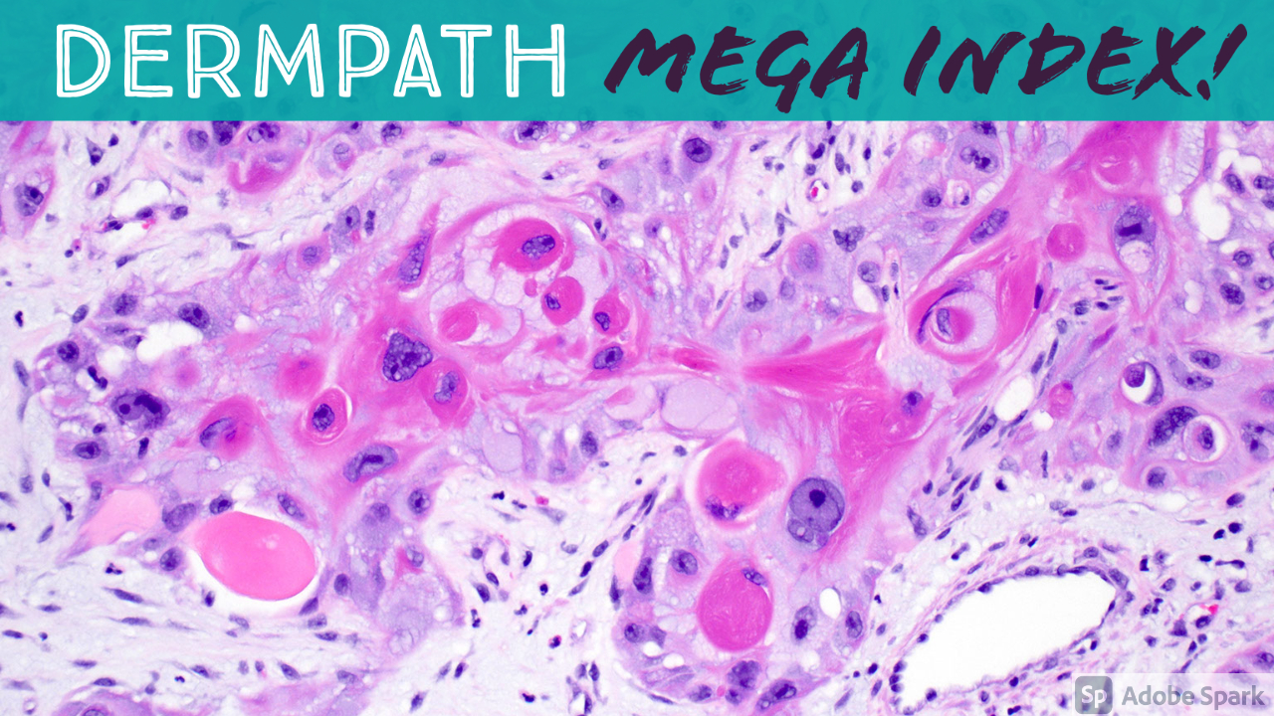
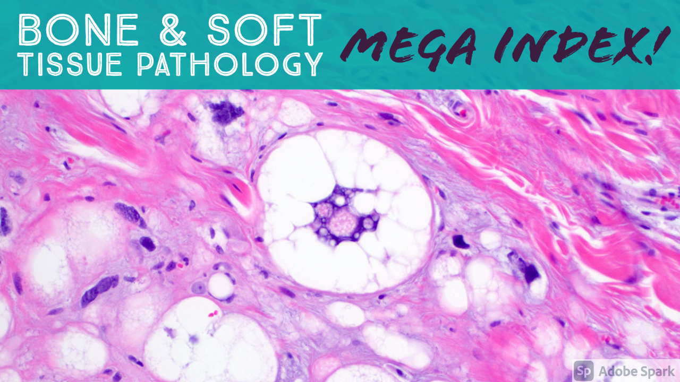
A complete organized library of all my videos, digital slides, pics, & sample pathology reports
kikoxp.com/posts/5084
kikoxp.com/posts/5083

Slide 4
How I use social media
Teaching & Learning
Networking
Patient Advocacy
Research
Communication
JMGardnerMD@gmail.com
Social Media 101: https://kikoxp.com/posts/15217
@JMGardnerMD

Slide 5
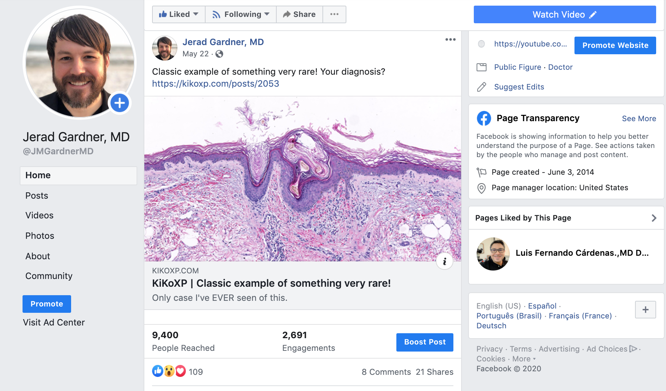
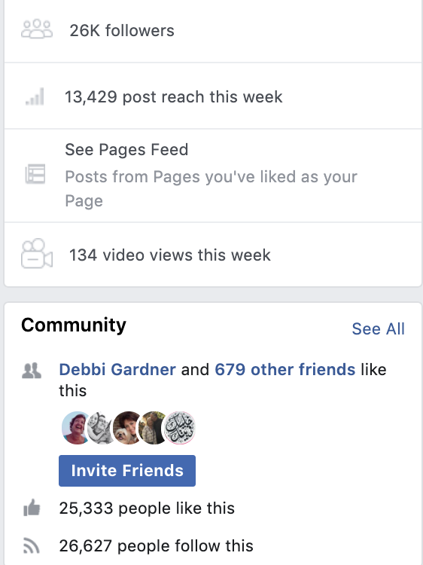
@JMGardnerMD

Slide 6
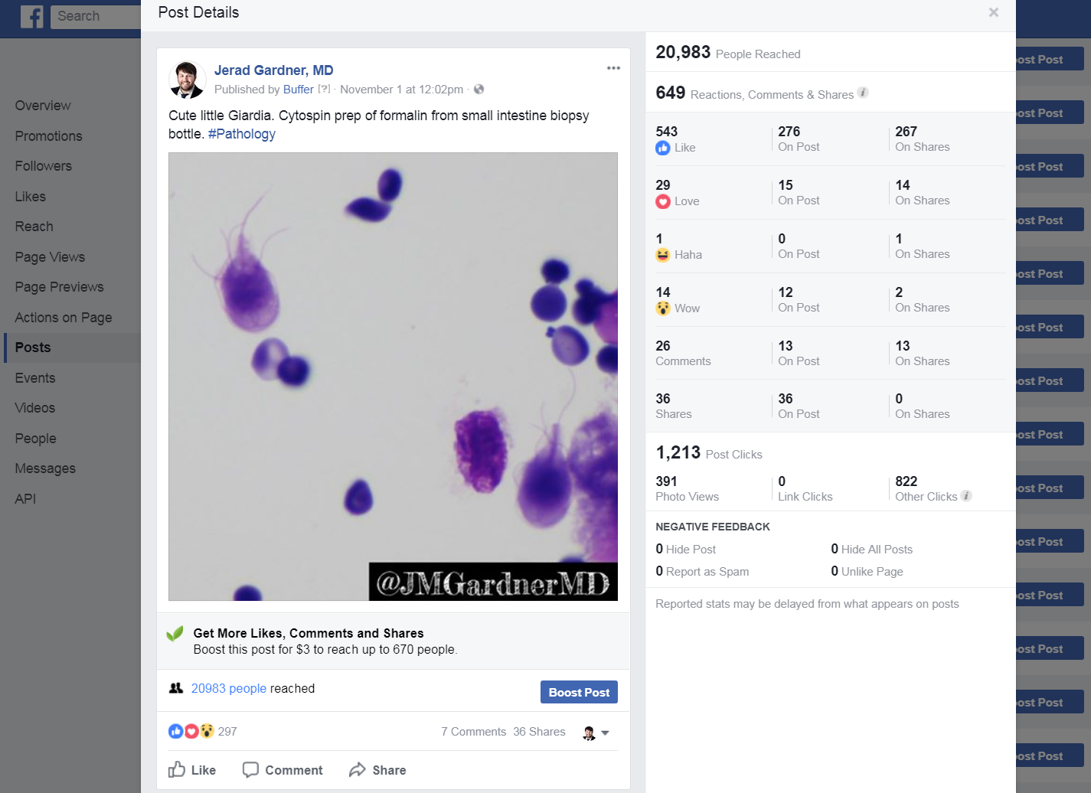
@JMGardnerMD

Slide 7
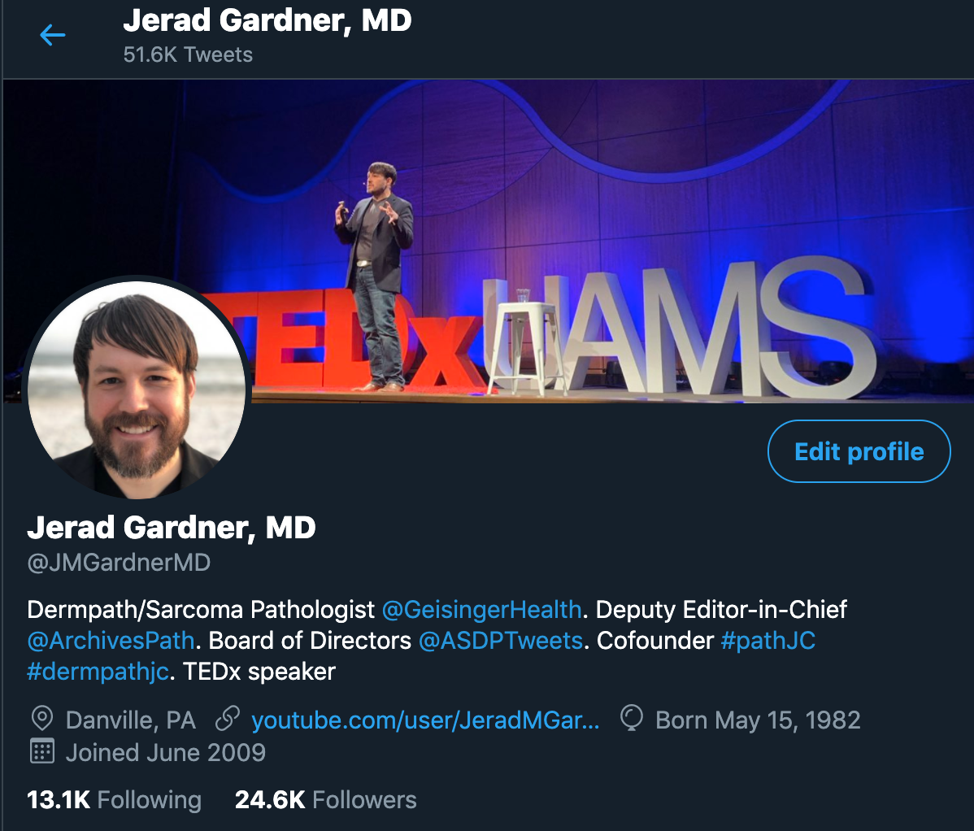

Slide 8
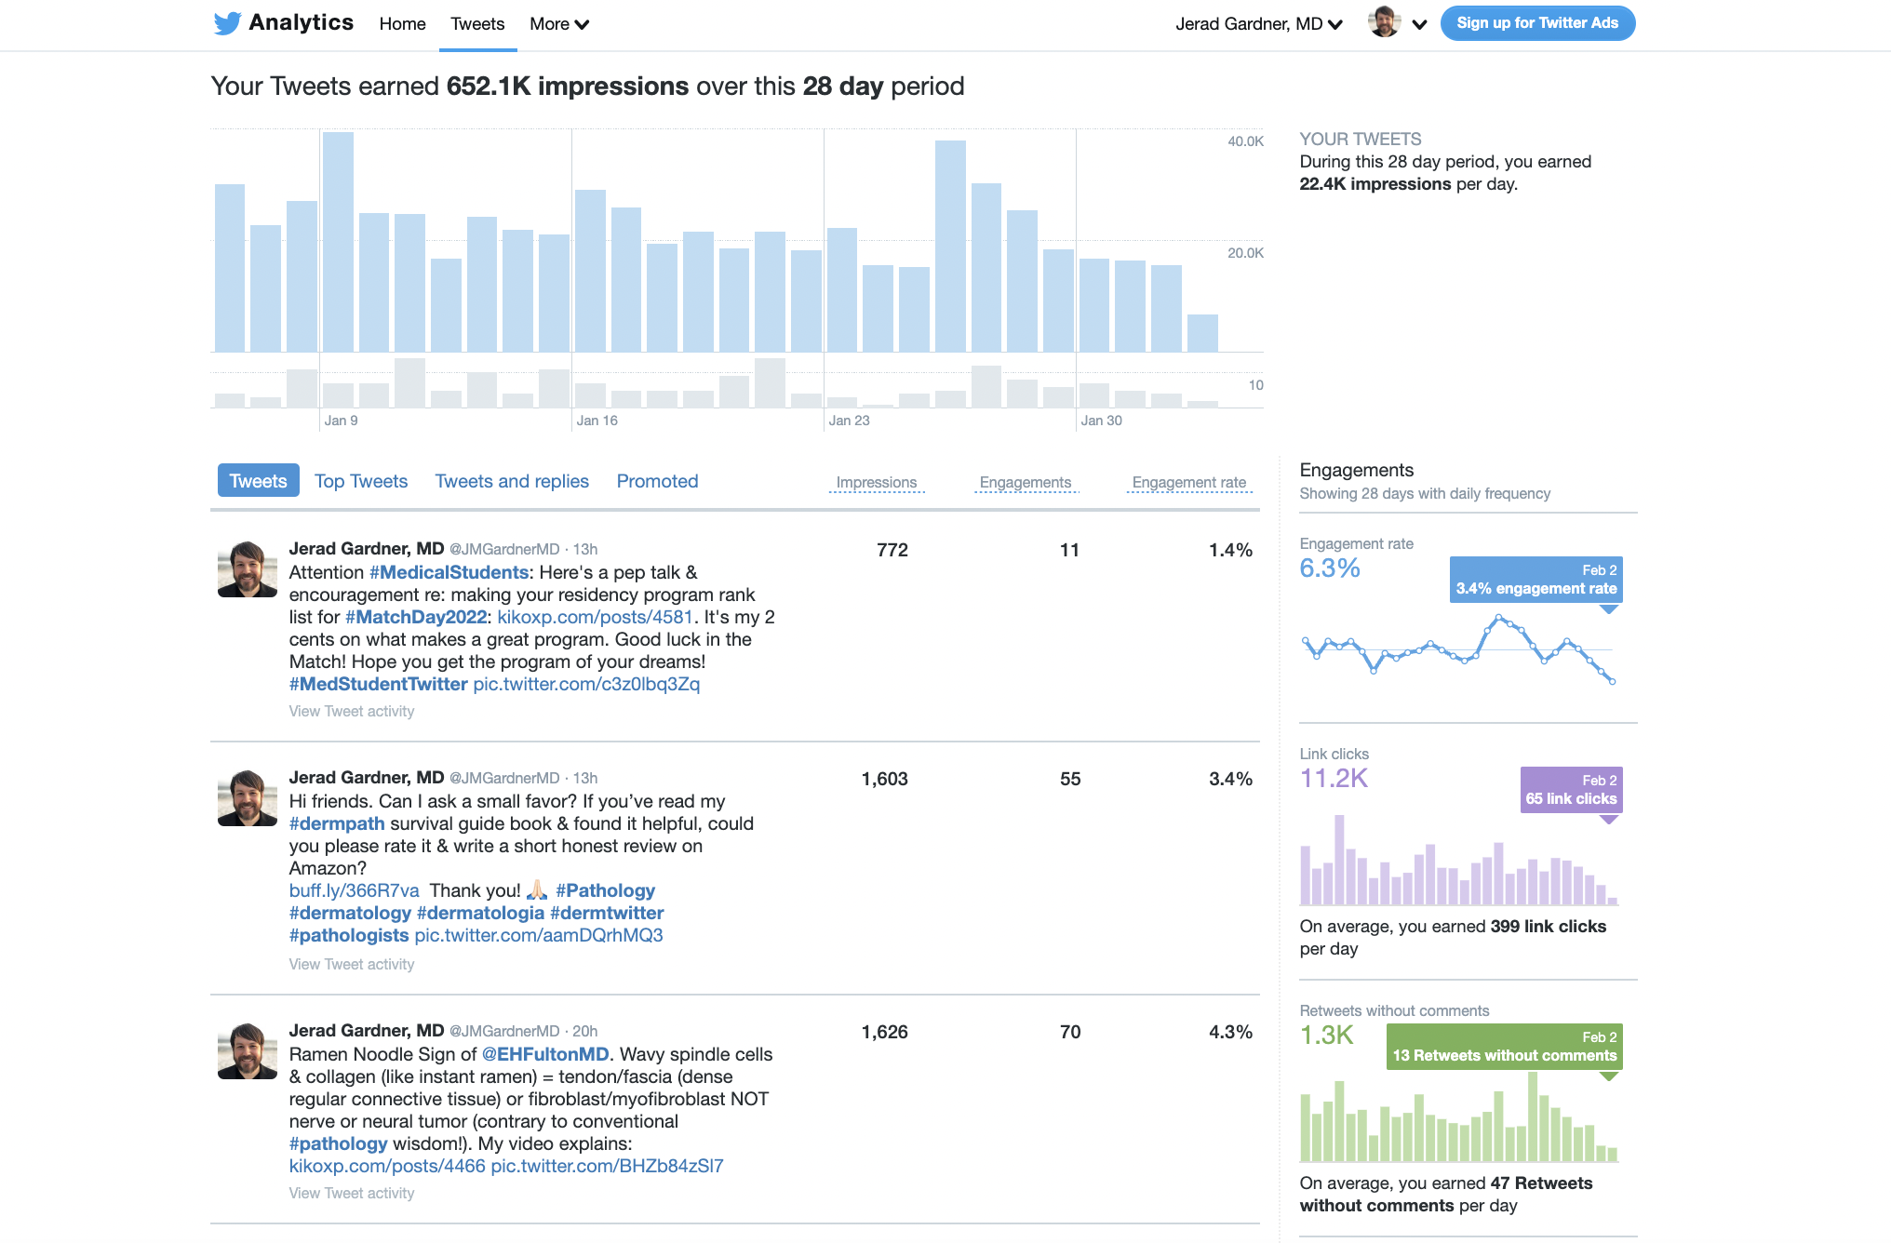
@JMGardnerMD

Slide 9
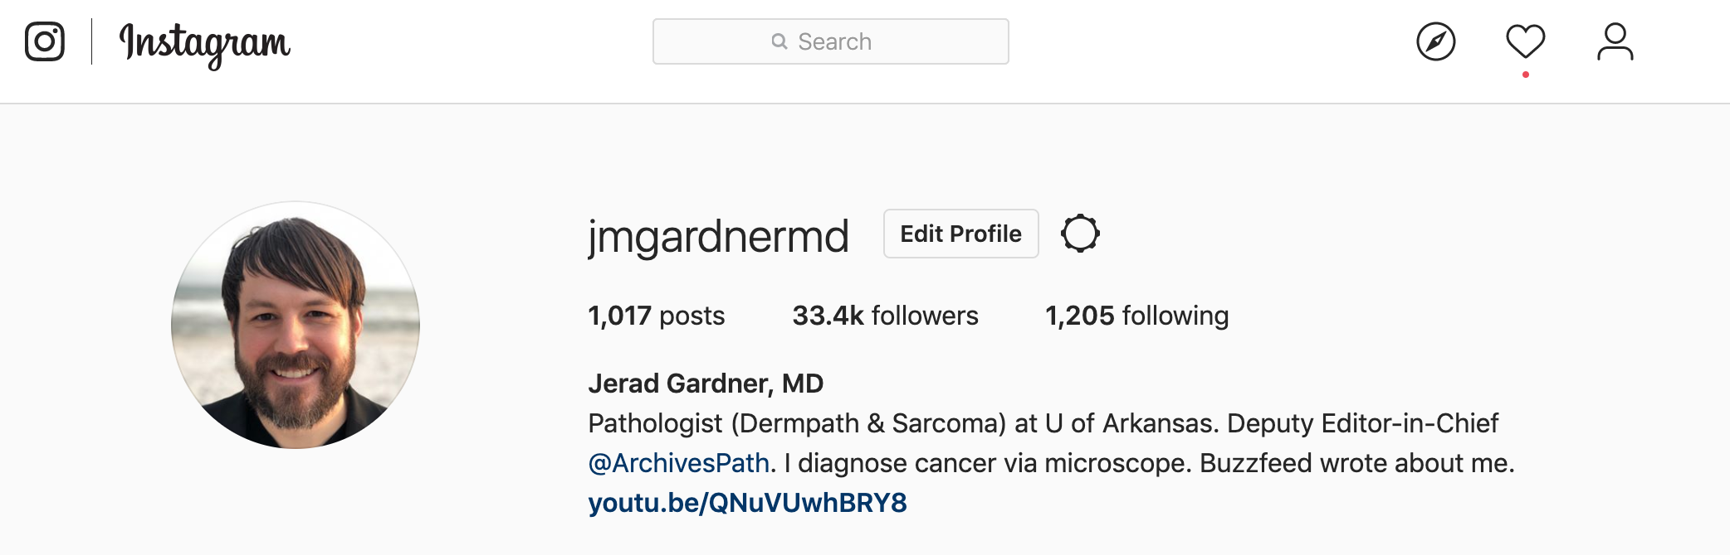
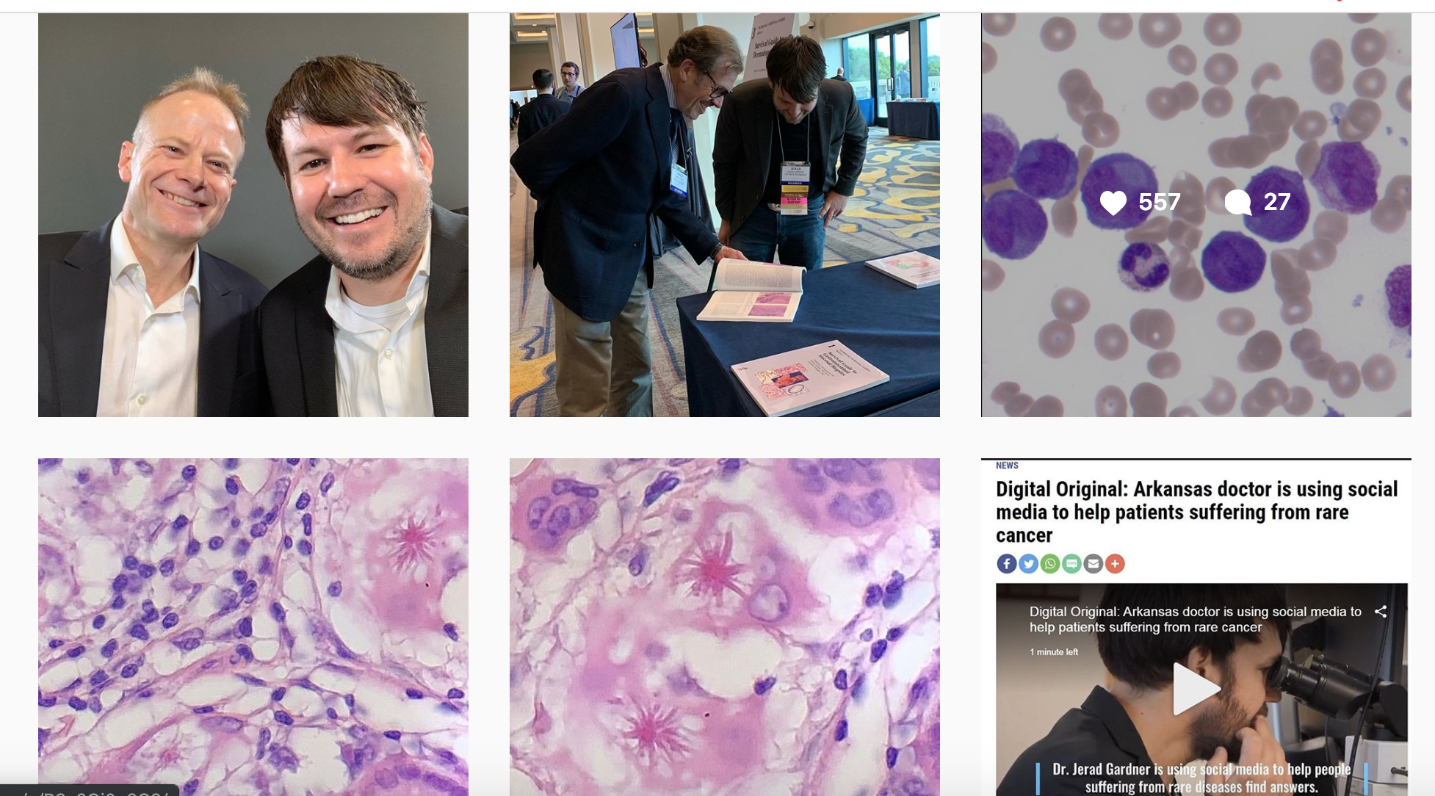

Slide 10
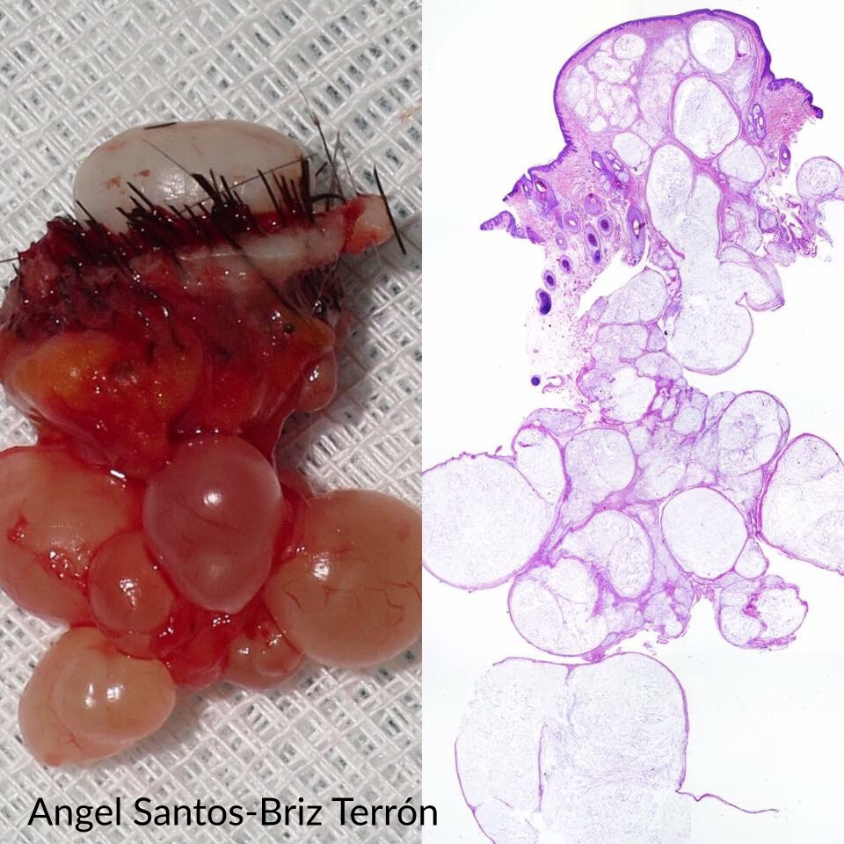
Nerve sheath myxoma

Slide 11
The @JMGardnerMD 30 day challenge
Check Twitter daily for a month
Retweet 3 things daily
Follow 3 new accounts daily
Make 1 tweet of your own per week
Social Media 101: https://kikoxp.com/posts/15217

Slide 12
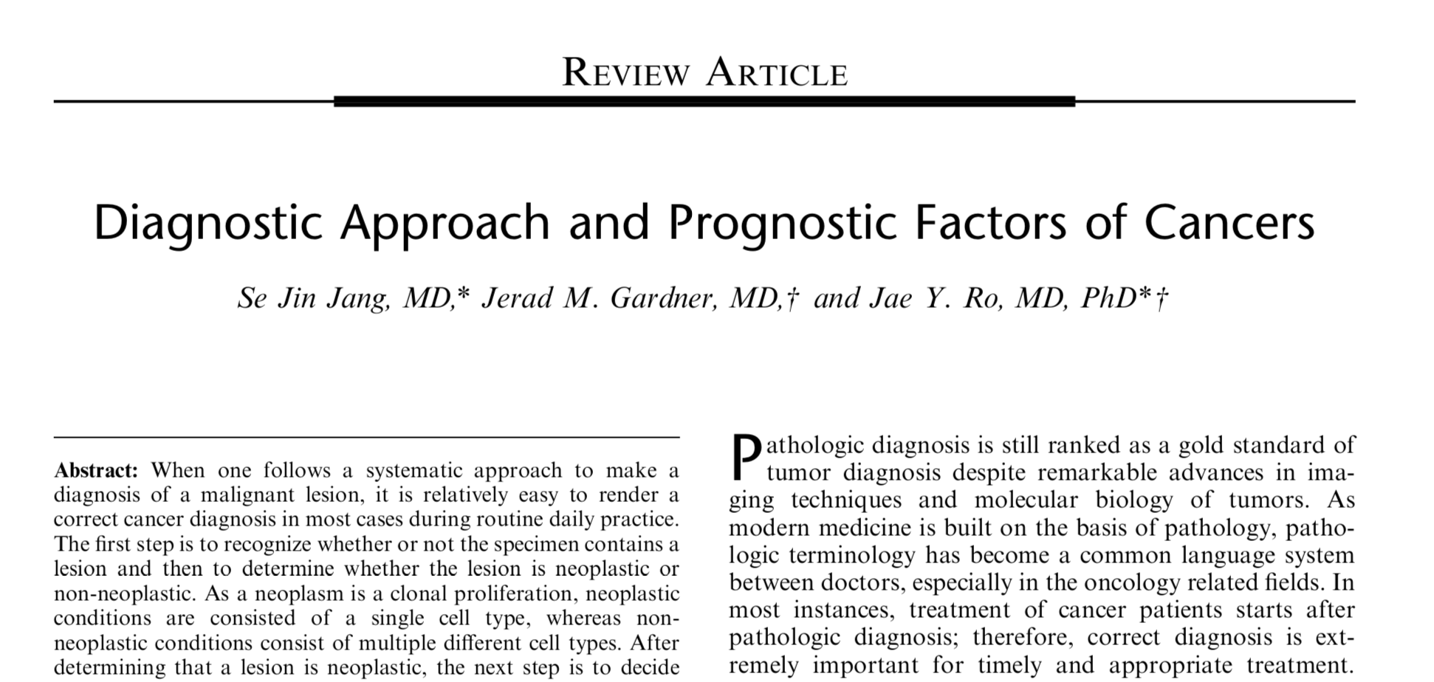
Widely share your publications
@JMGardnerMD

Slide 13
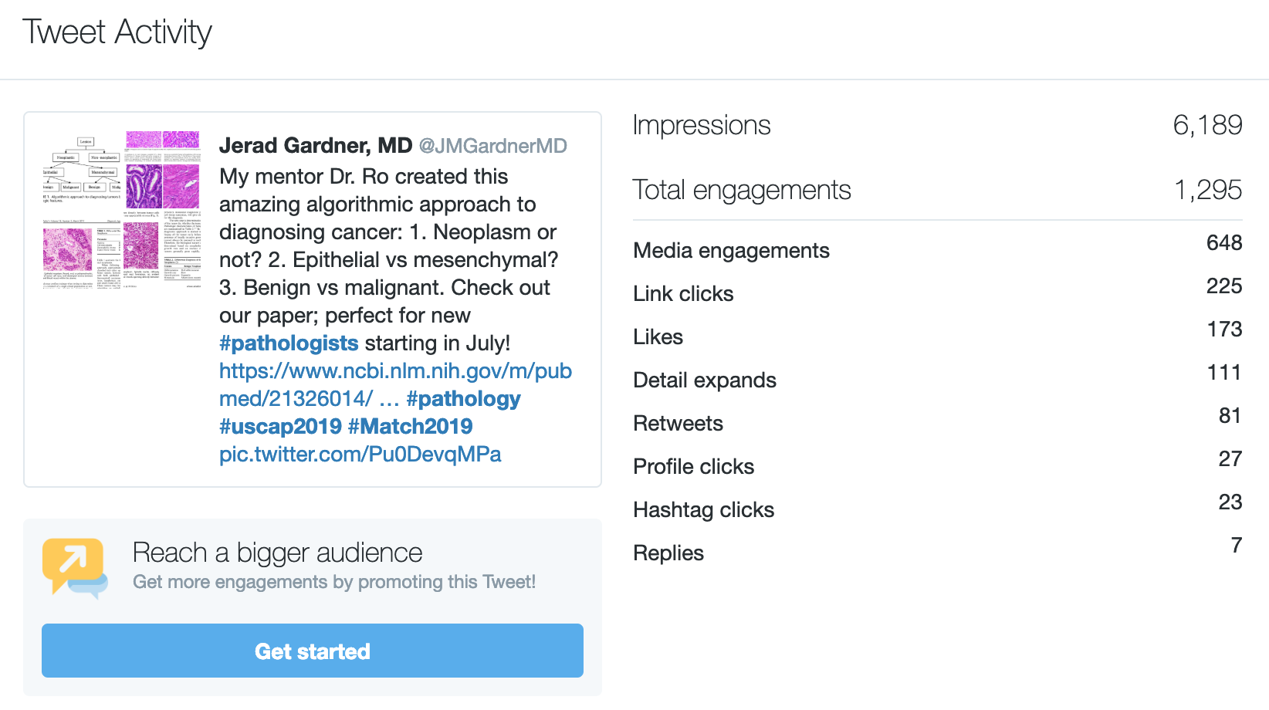
6,000+ views in 24 hours!

Slide 14
But I already use facebook. Why should I use twitter?
Instant connection to amazing global community
Regardless of where you practice
Regardless of your academic rank/fame
Meet awesome people you would never have met in real life
@JMGardnerMD
Social Media 101: https://kikoxp.com/posts/15217

Slide 15
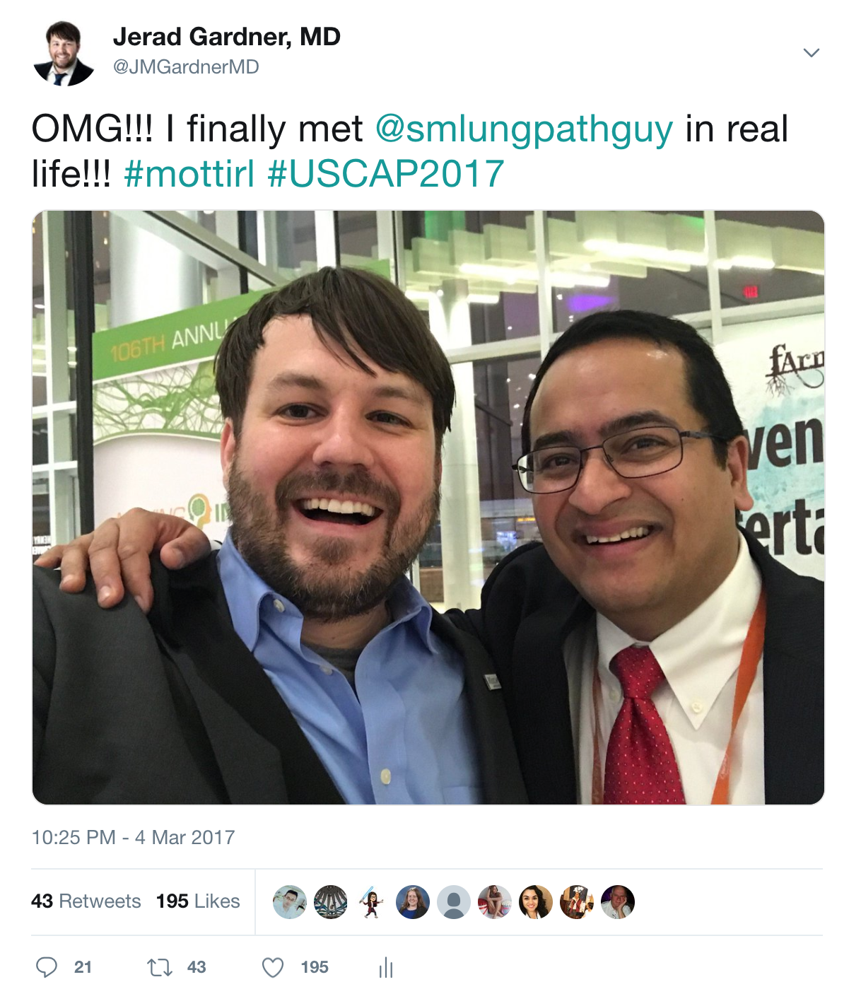
#mottirl (met on twitter then in real life)
@JMGardnerMD

Slide 16
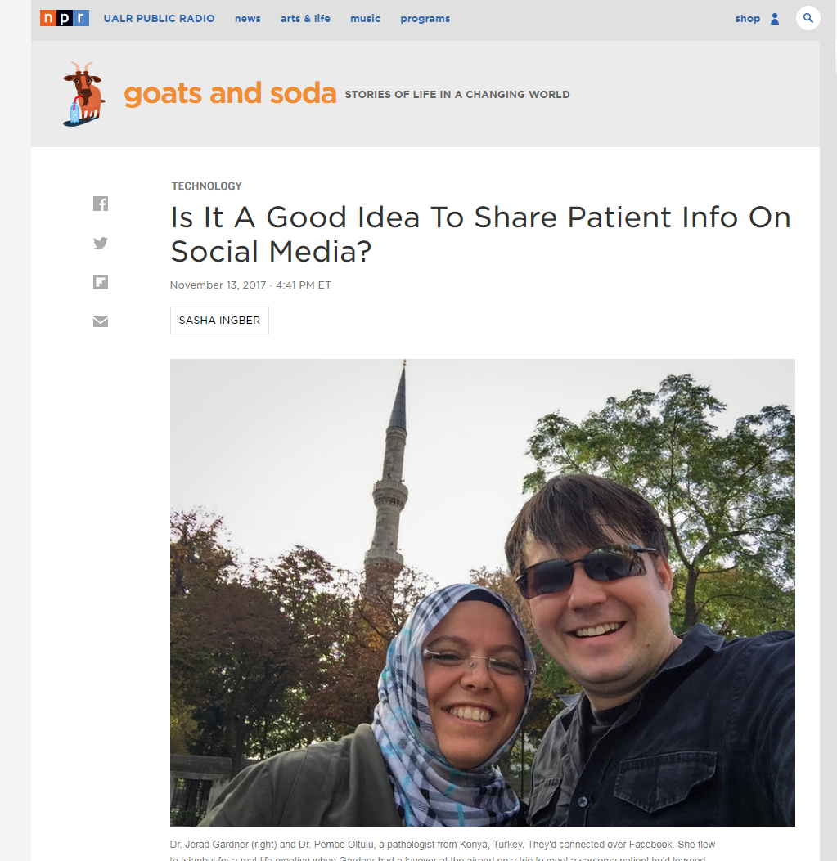
@JMGardnerMD

Slide 17
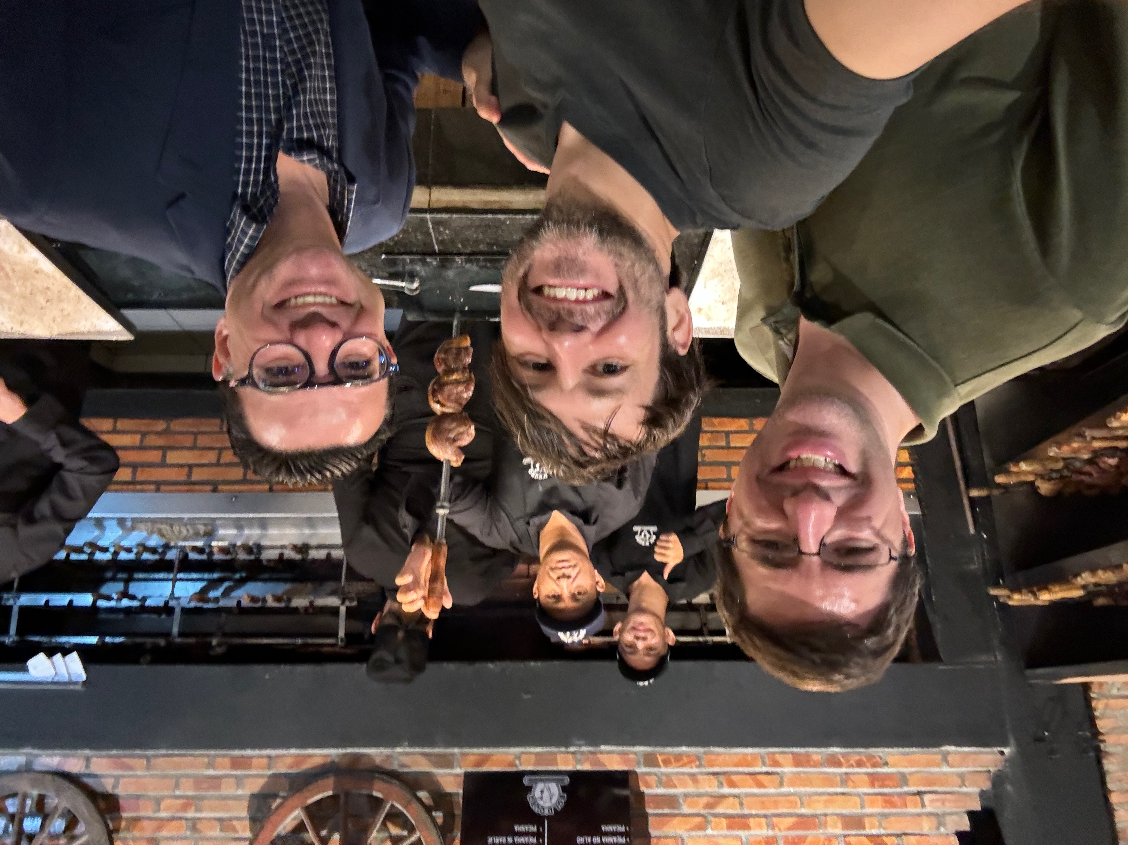

Slide 18
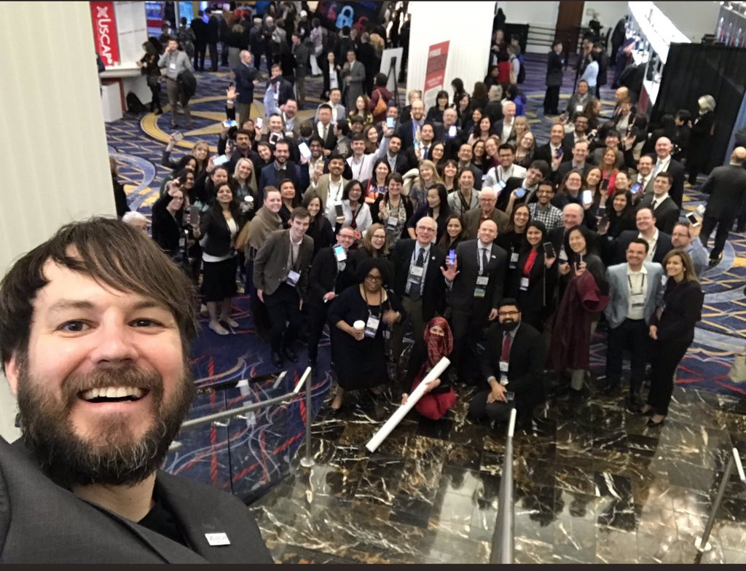
Tweet up at USCAP 19

Slide 19
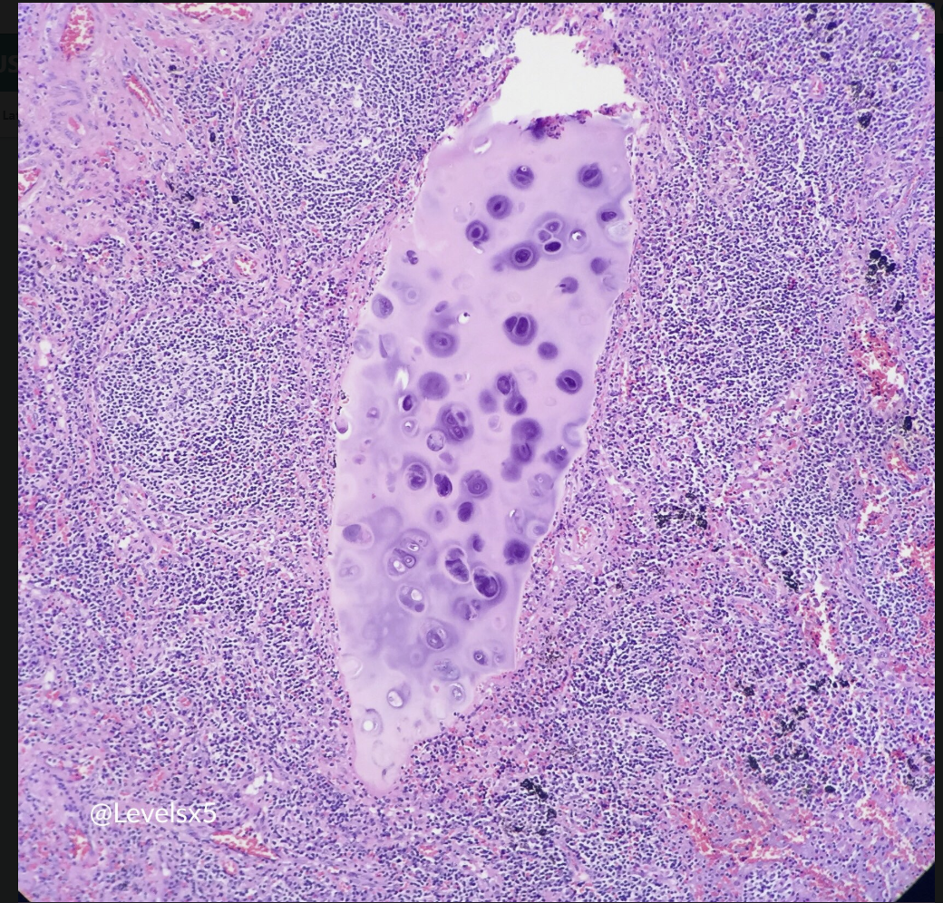
Research collaborations

Slide 20
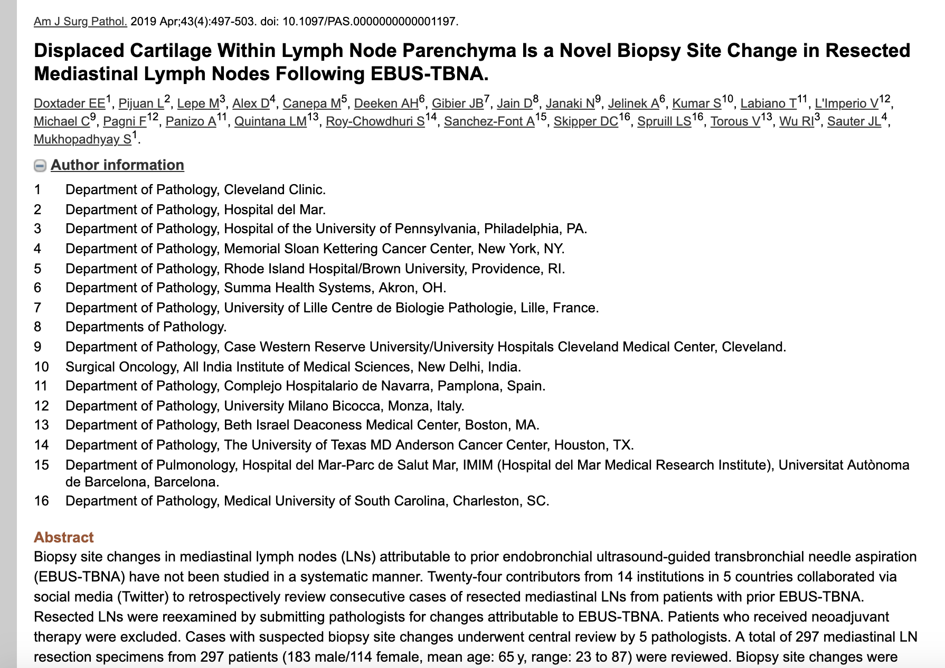
AJSP 2019
24 pathologists
5 countries
100% because of Twitter!

Slide 21
#dermpathjc (Twitter dermatopathology journal club)
@JMGardnerMD
Social Media 101: https://kikoxp.com/posts/15217

Slide 23
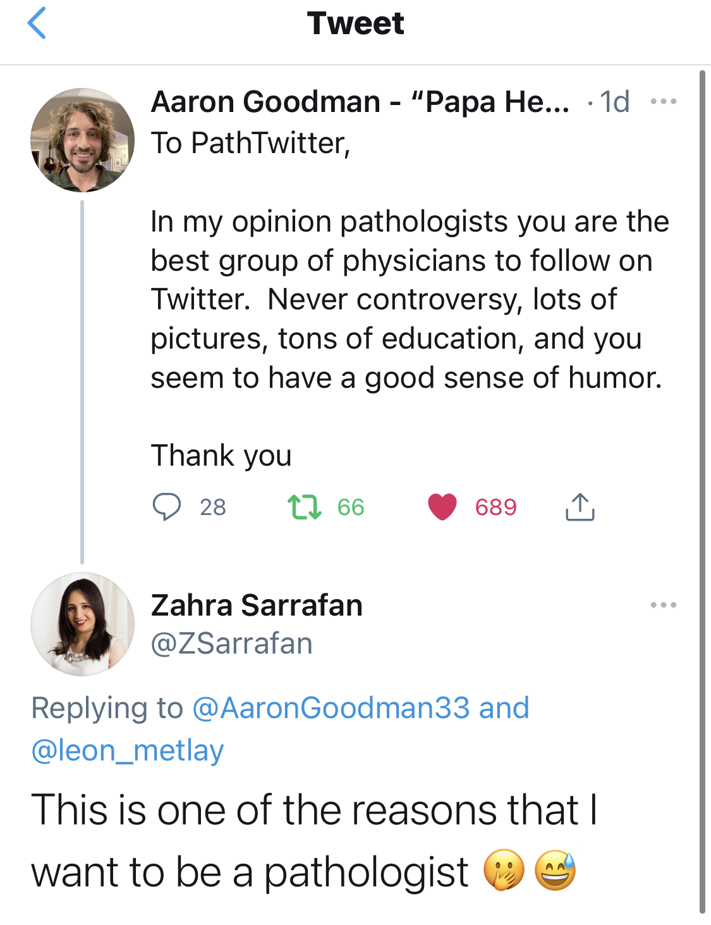
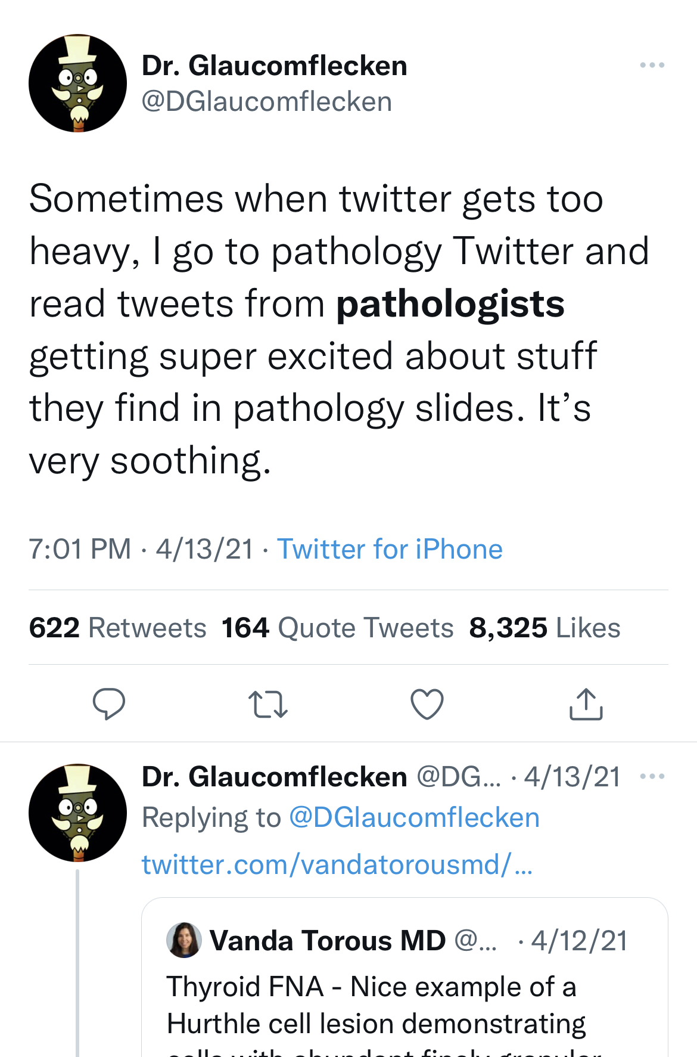

Slide 24
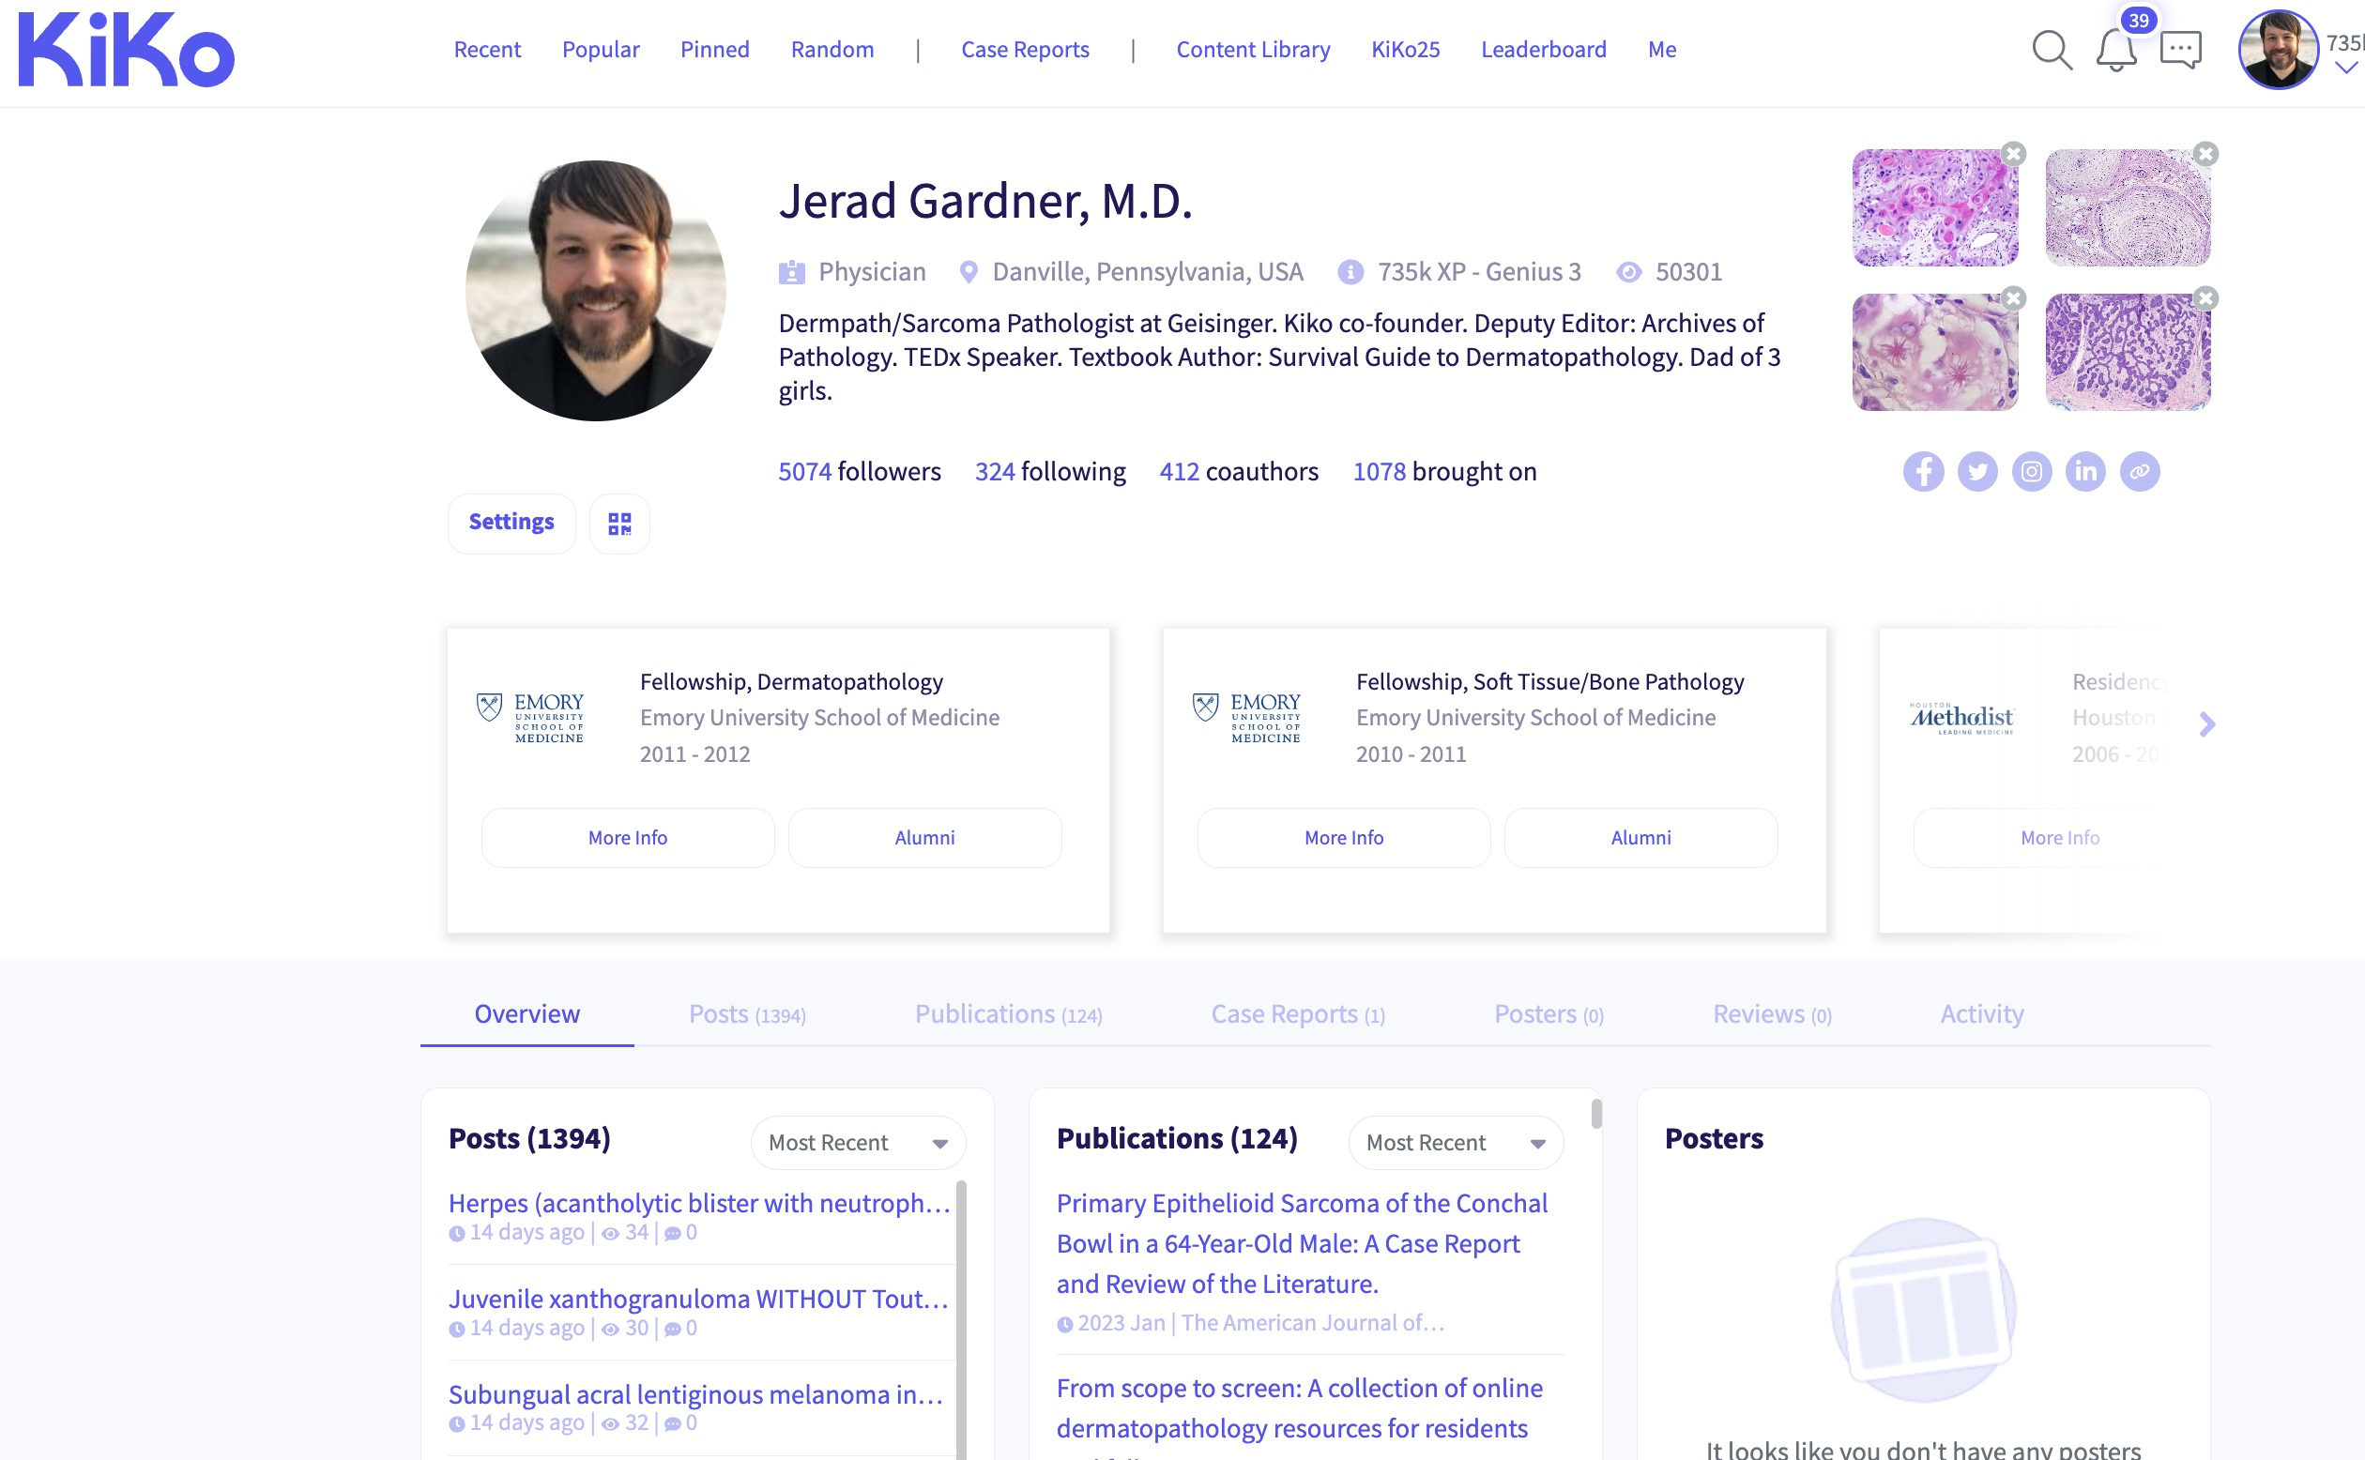

Slide 25
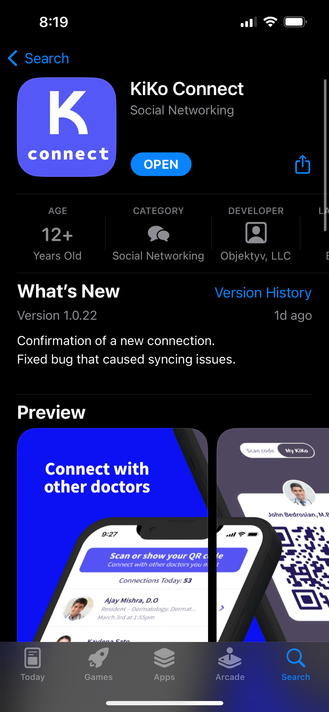
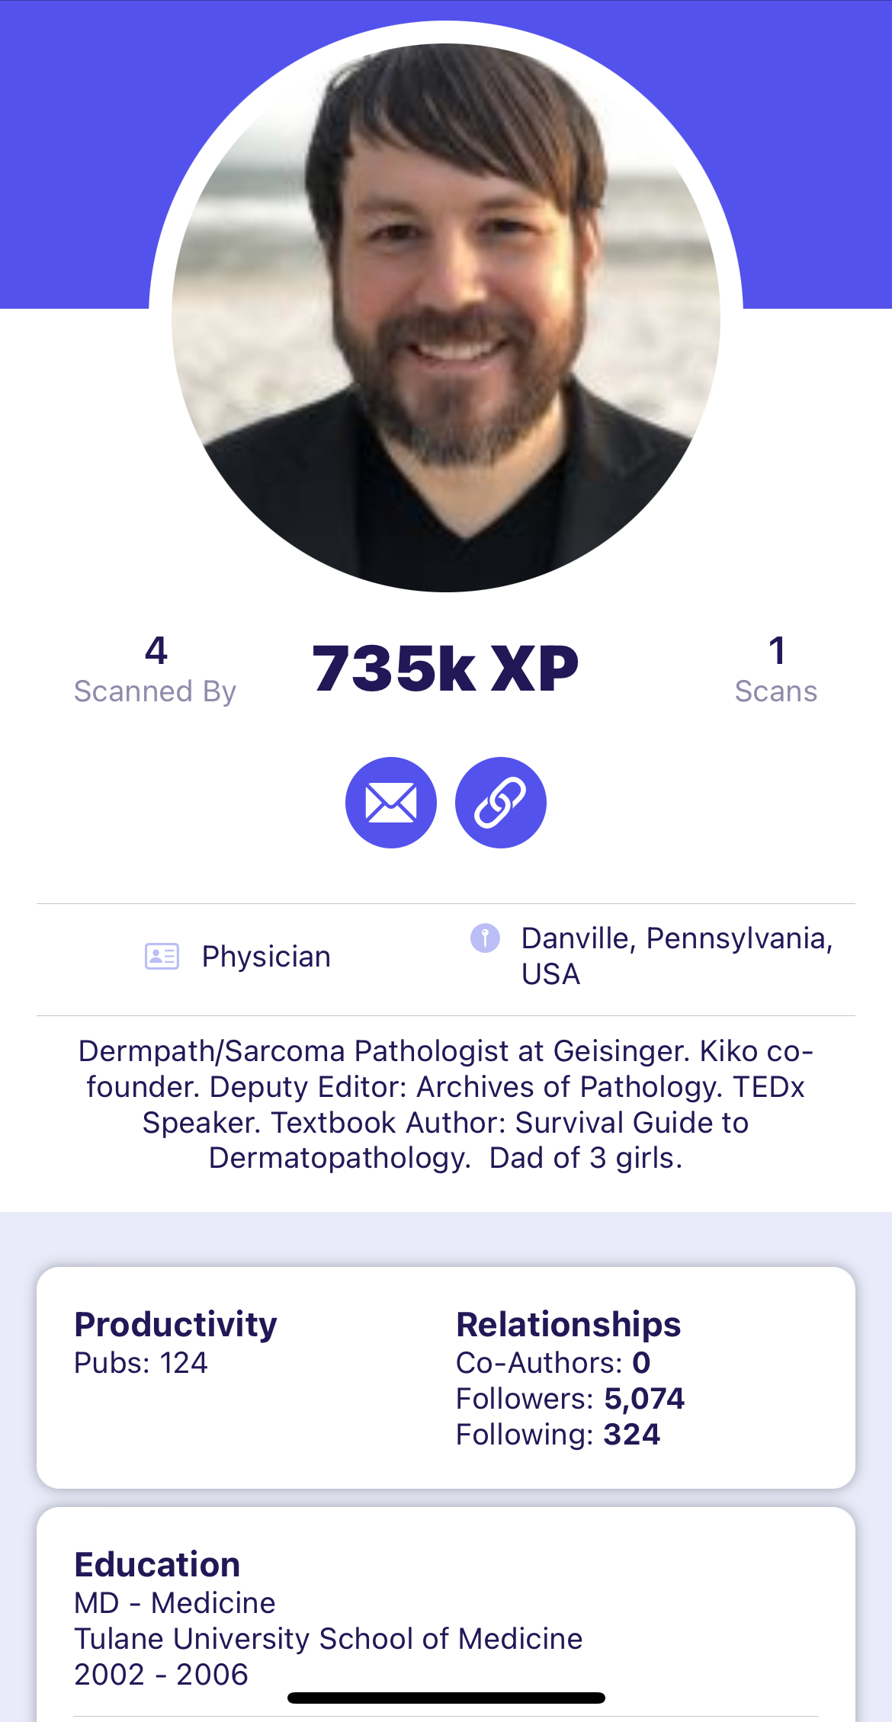
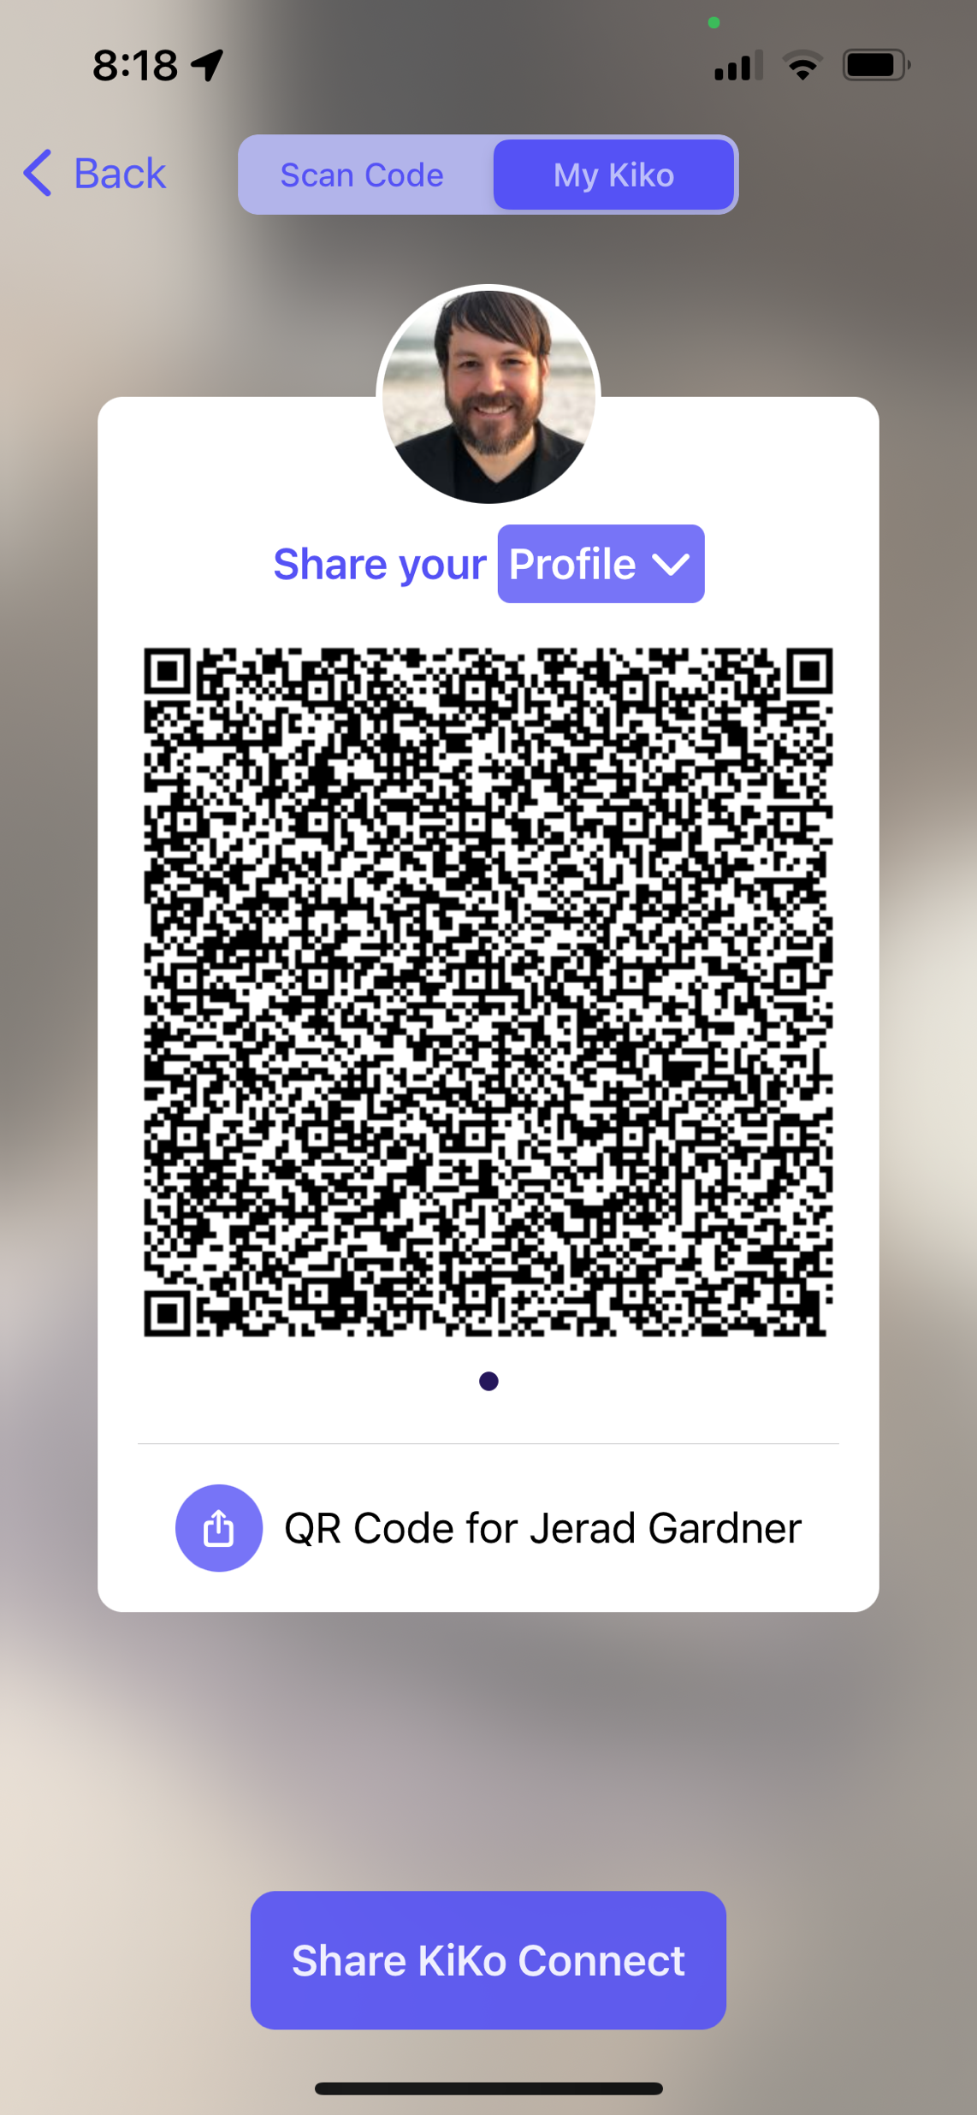

Slide 26
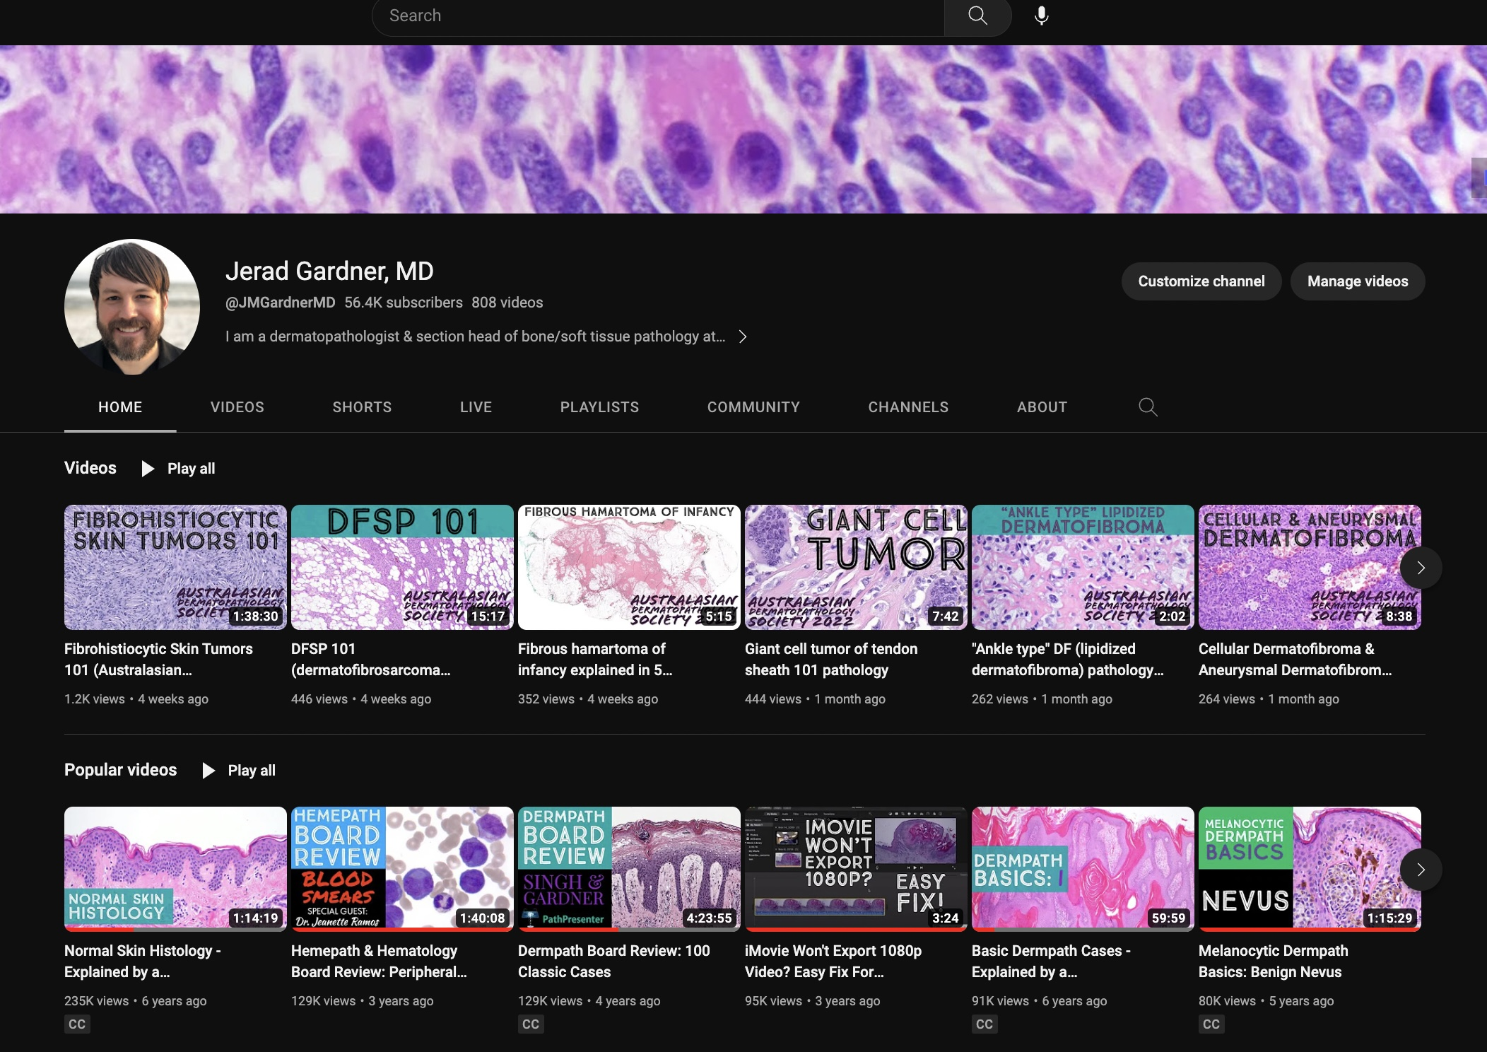
@JMGardnerMD

Slide 27
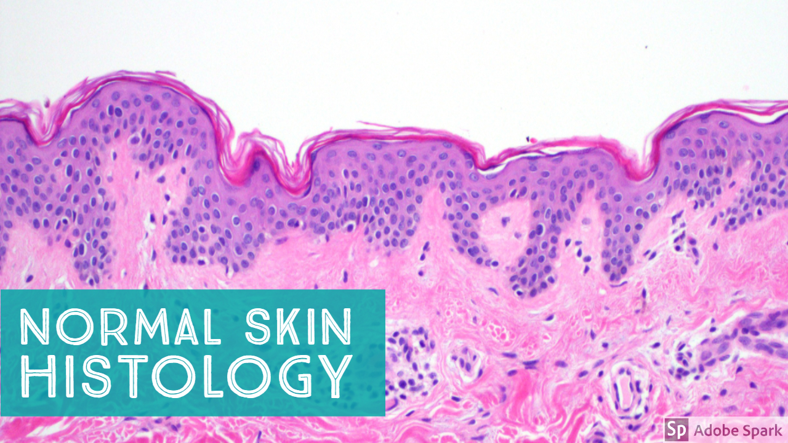
You can teach intro level basic information…

Slide 28
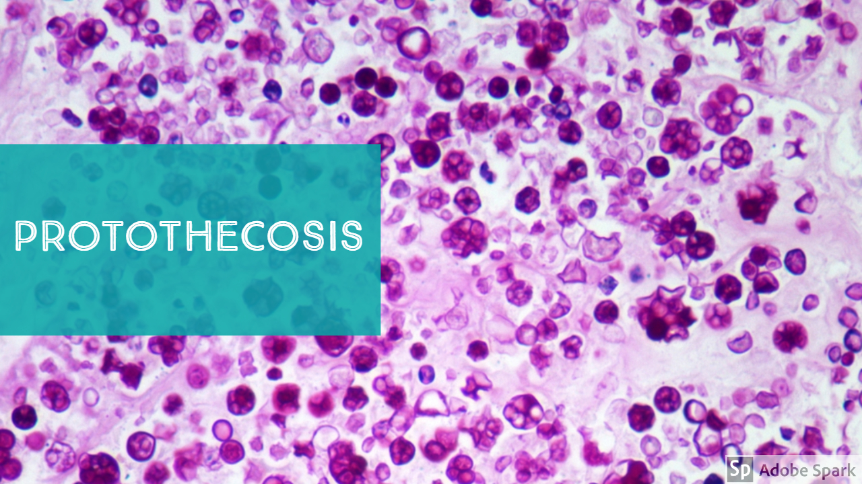
…and you can teach esoteric fellowship level advanced information

Slide 29
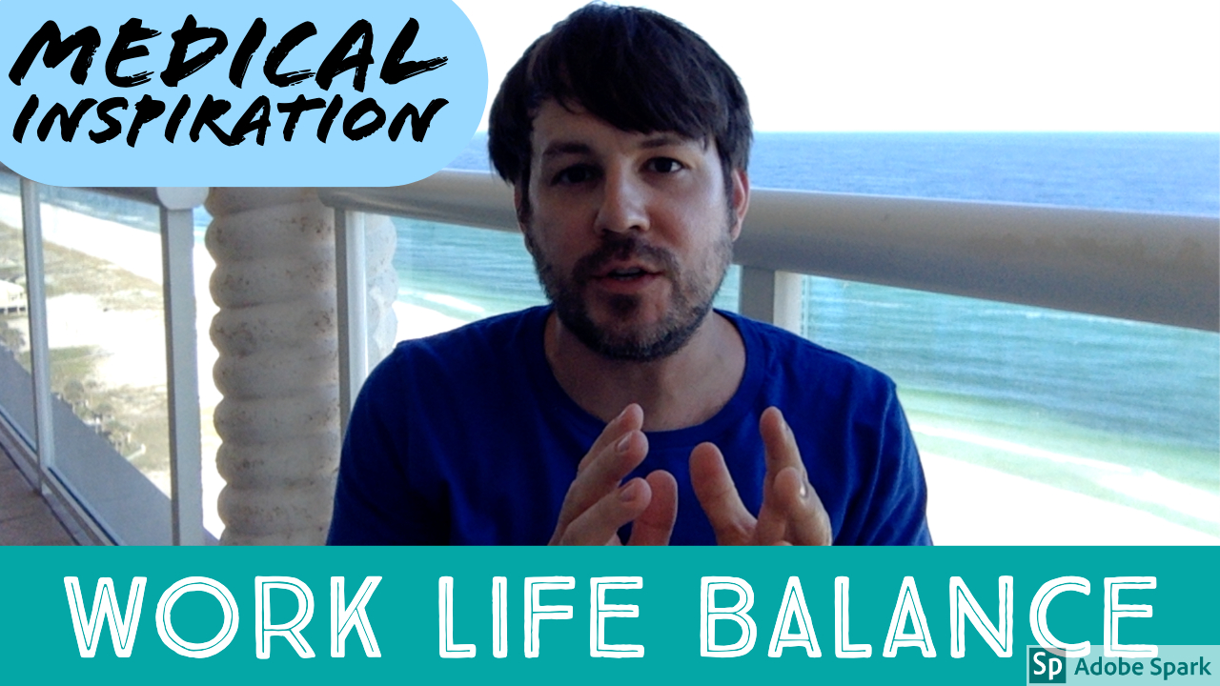

Slide 30
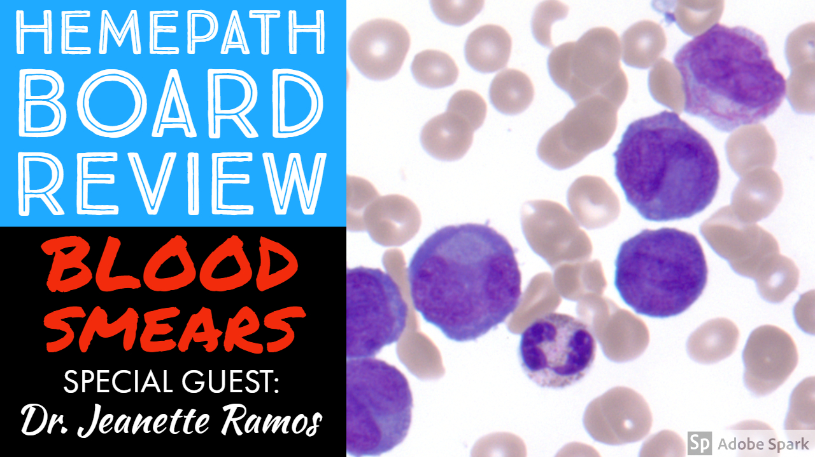

Slide 31
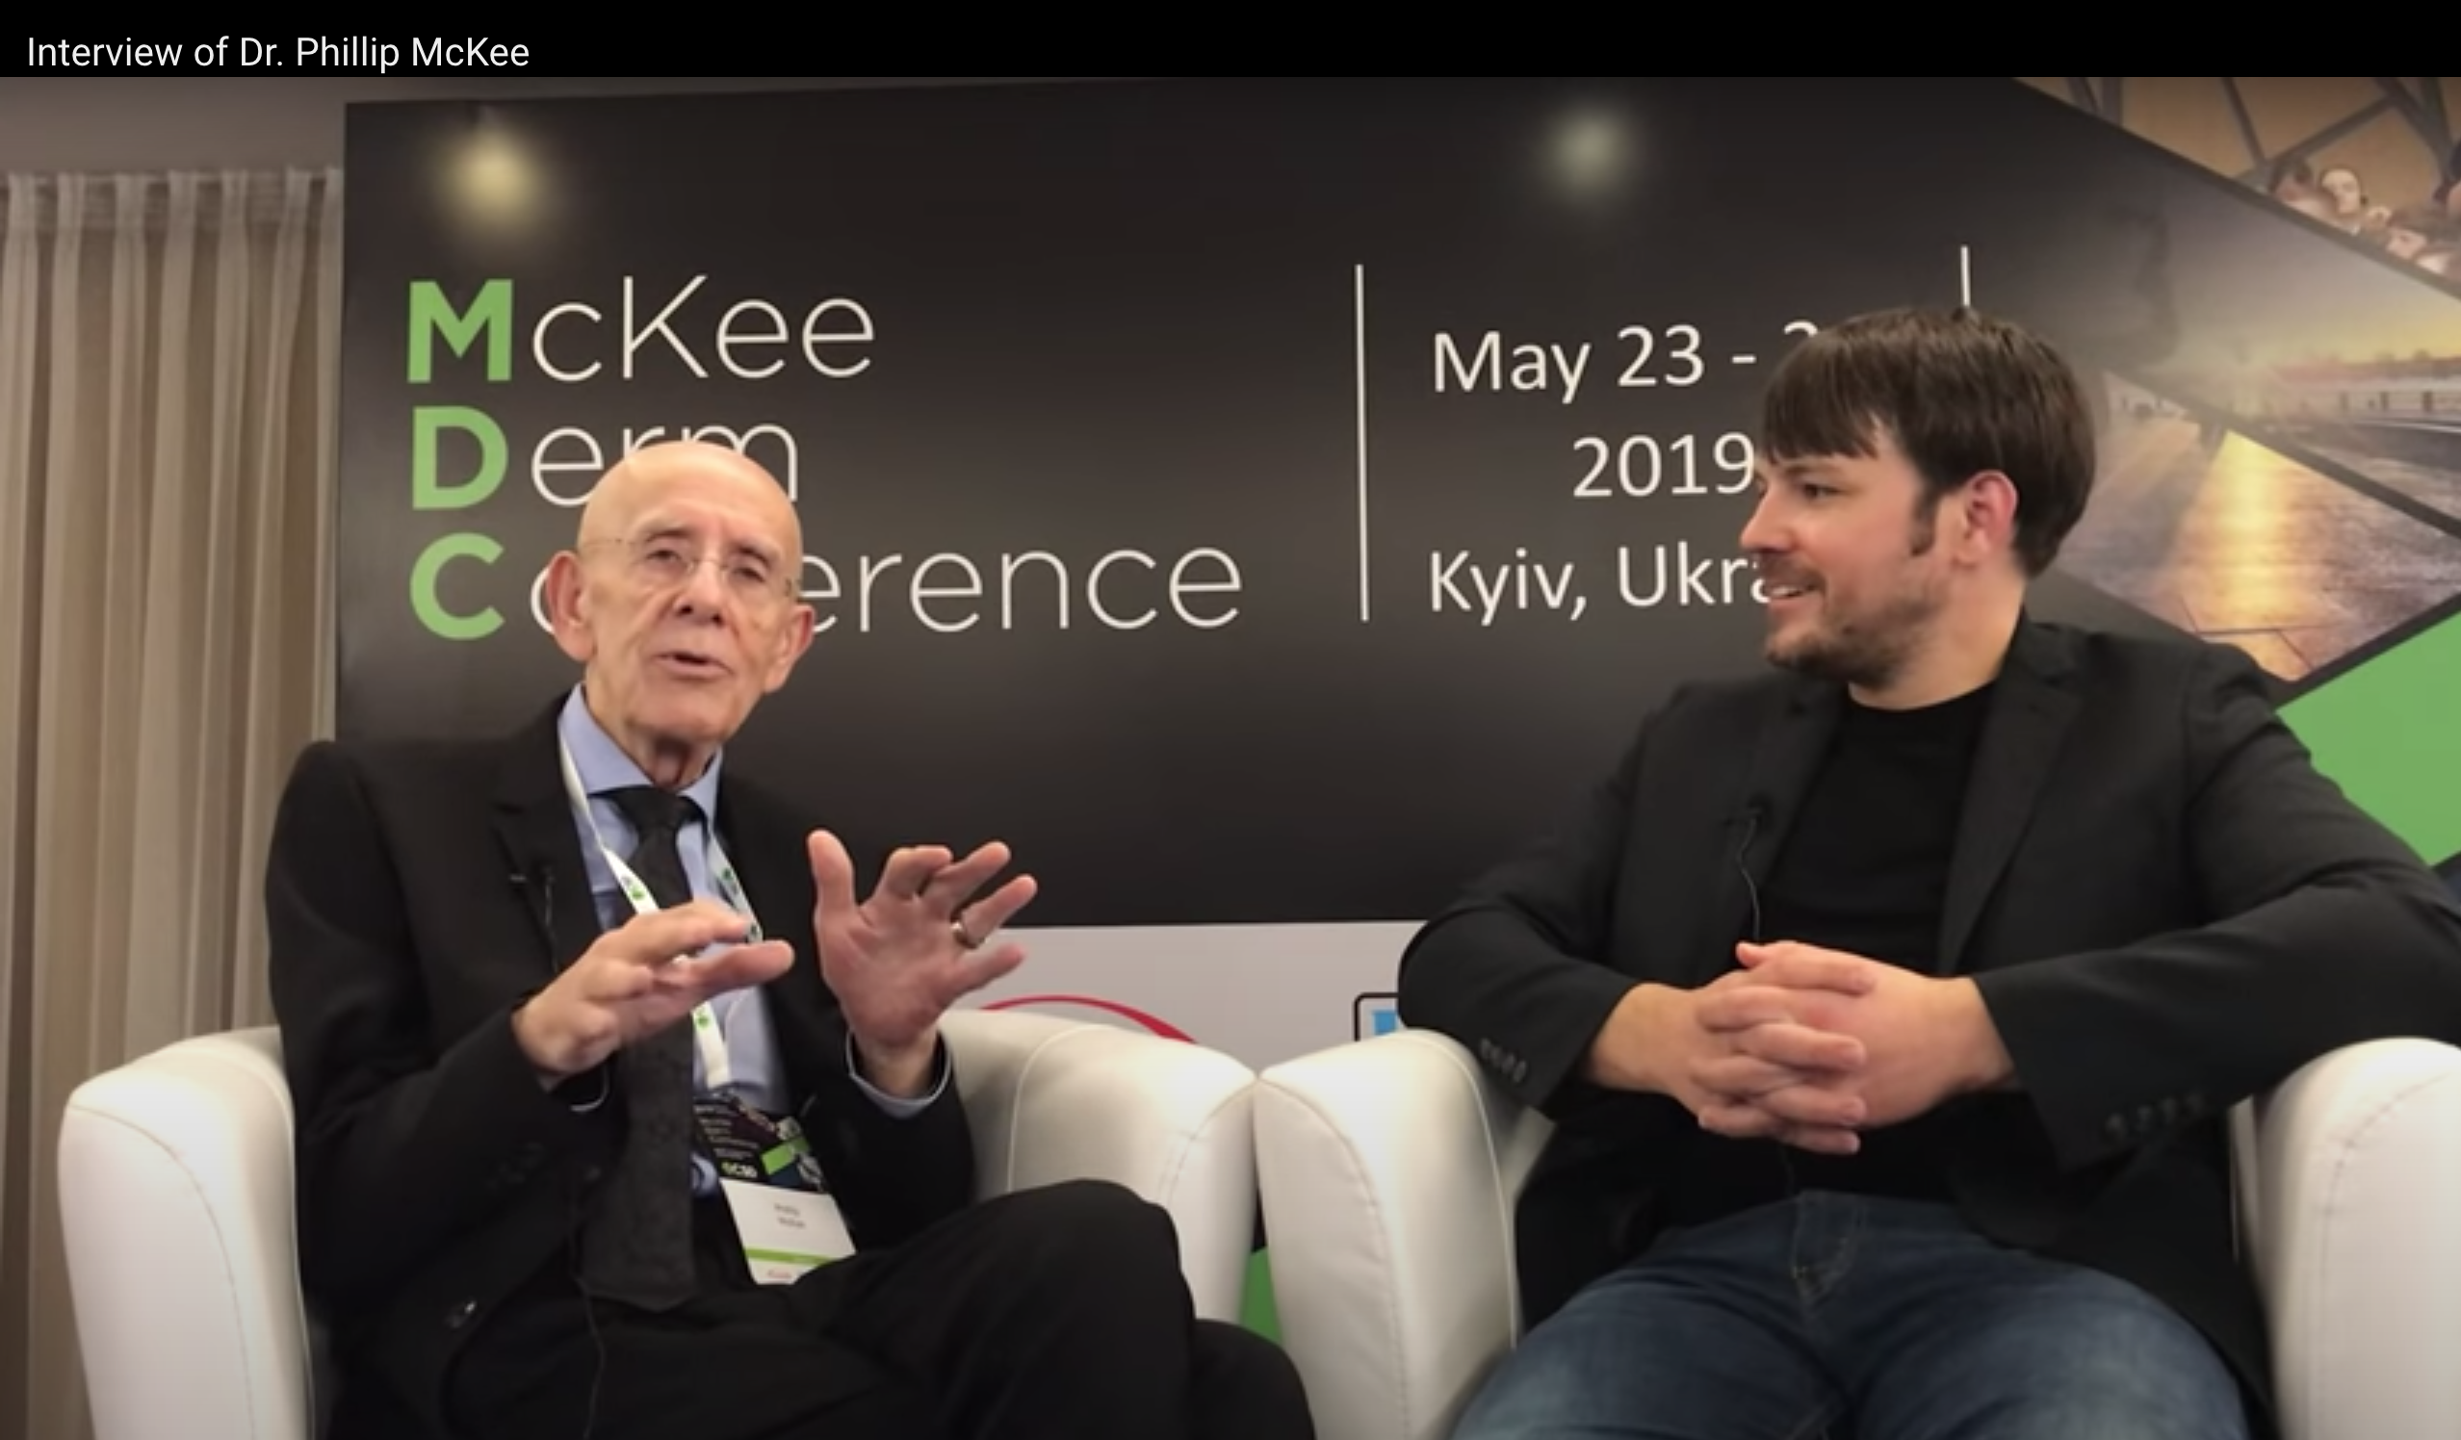

Slide 32
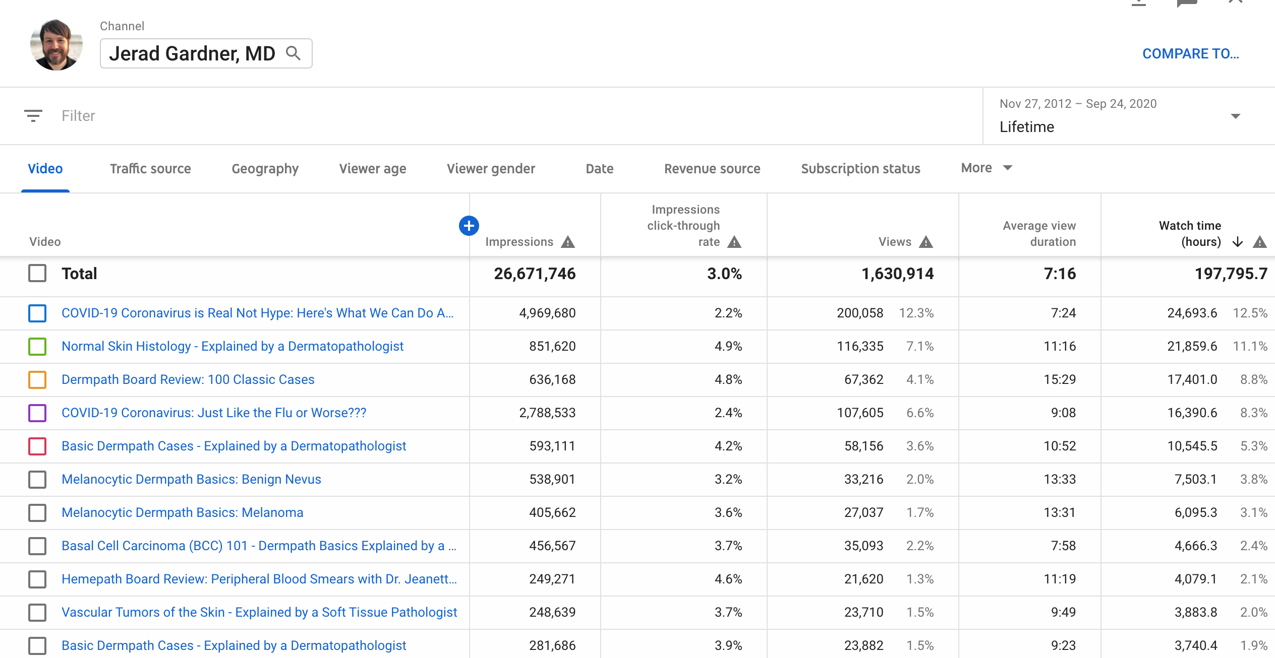
@JMGardnerMD

Slide 33
11,000 views in last 48 hours
My pathology videos are viewed 24/7/365
I’m teaching constantly, even when I’m sleeping!
@JMGardnerMD

Slide 34
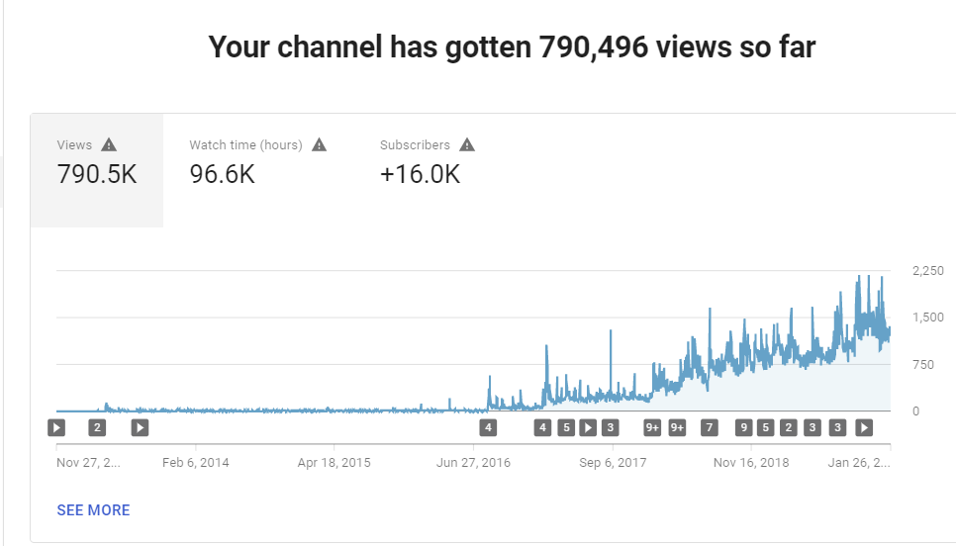
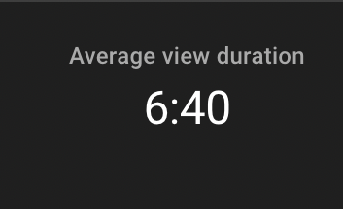
@JMGardnerMD

Slide 35
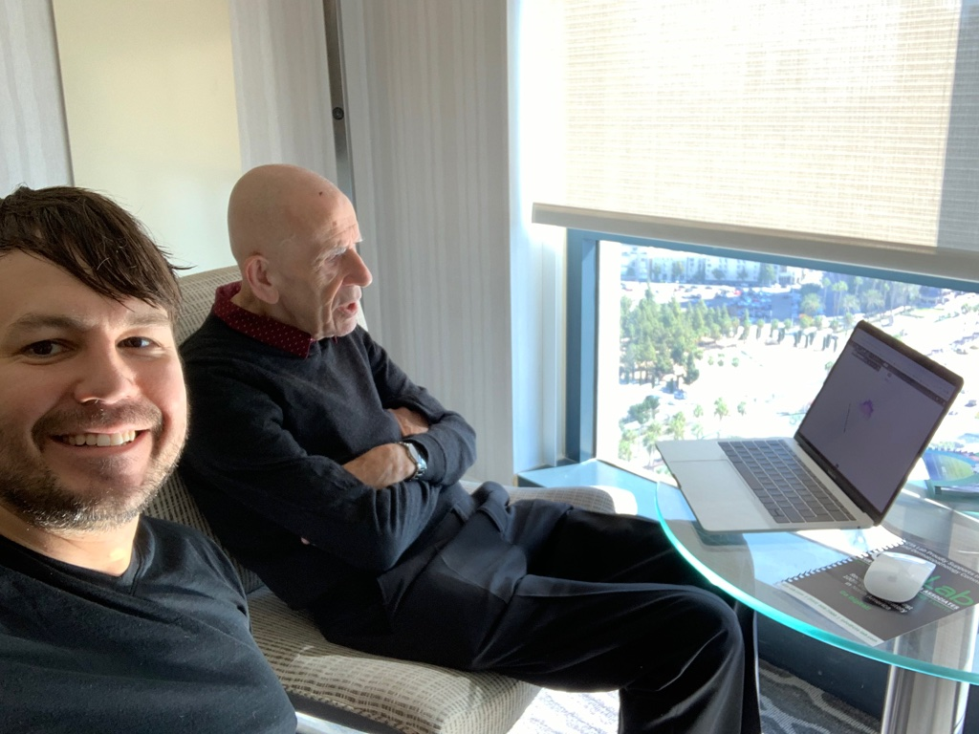
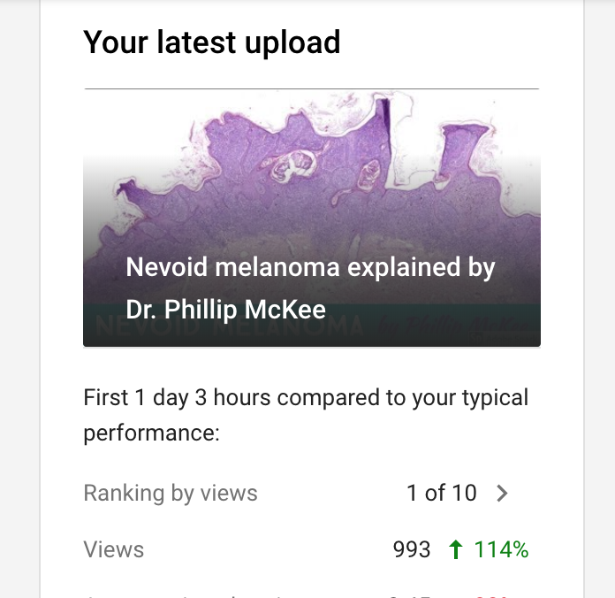

Slide 36
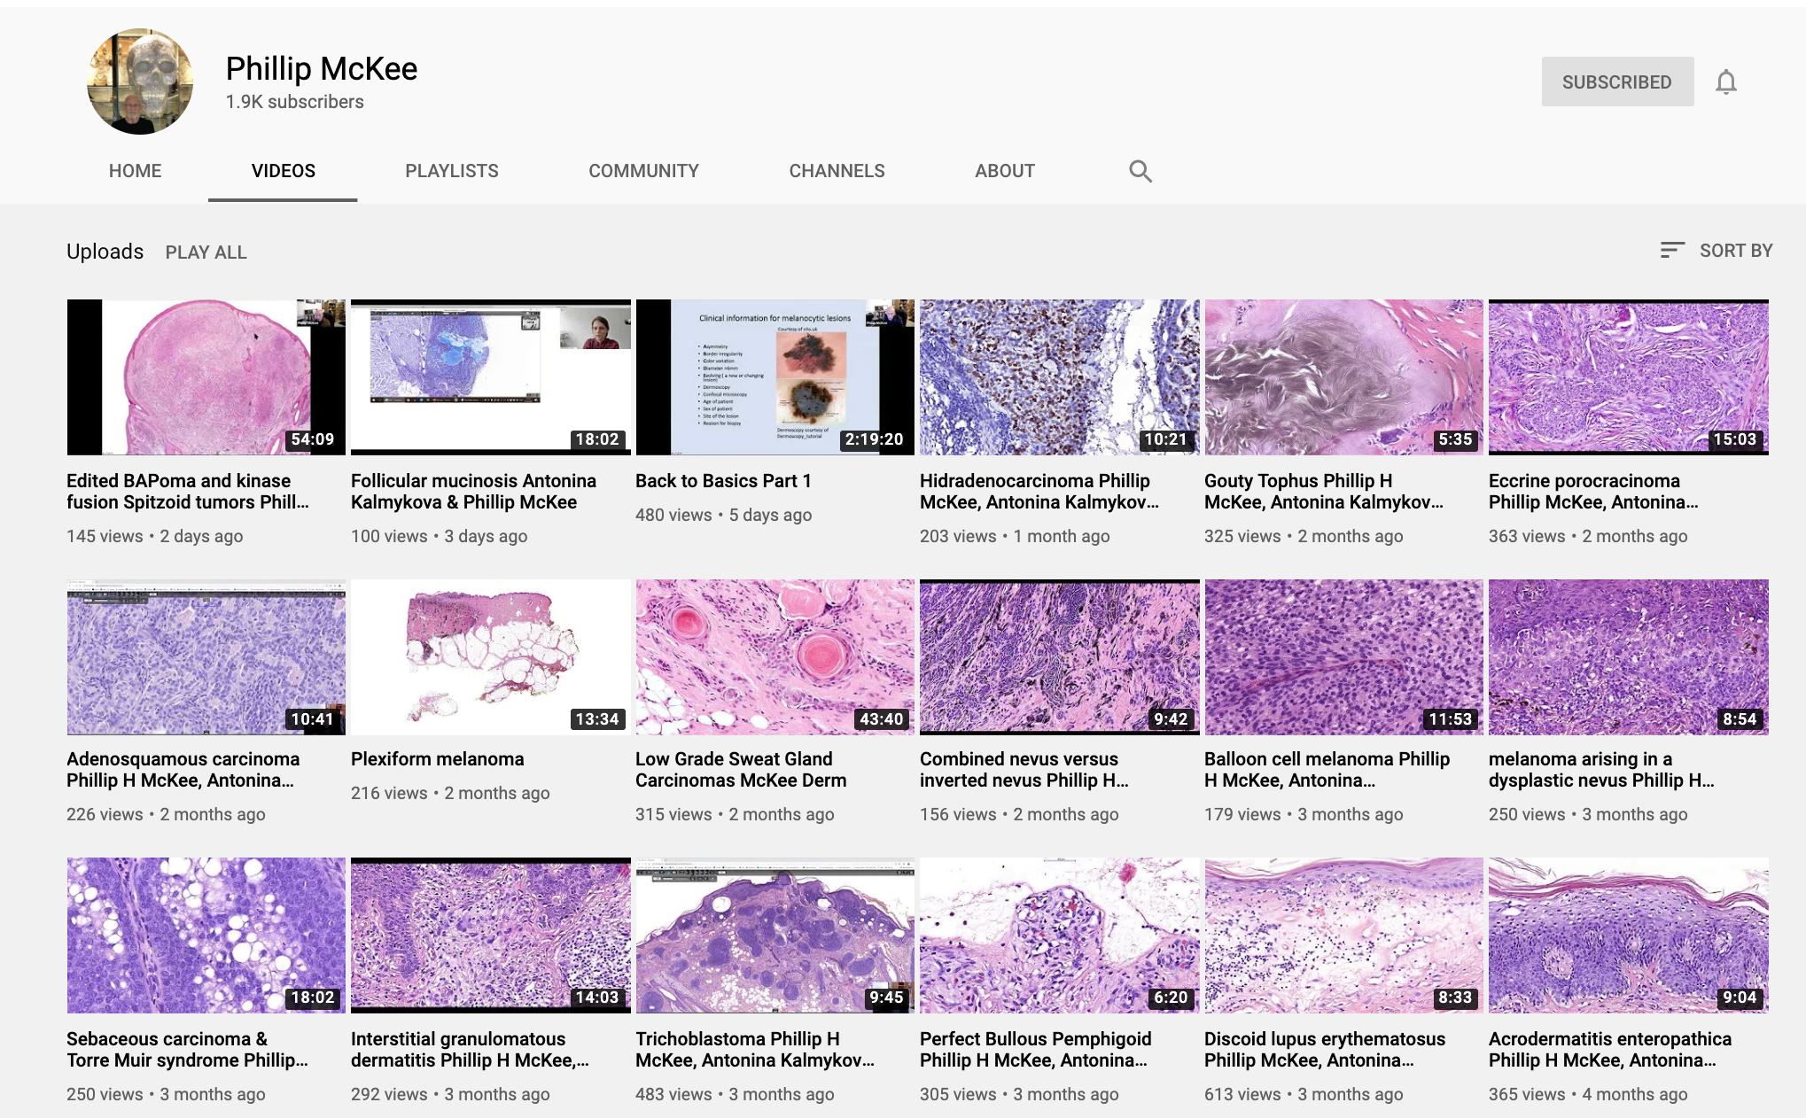

Slide 37
Screen recording is the key!
When I give a virtual lecture, I make a screen recording
I’ve already done hard work and spent time preparing/giving lecture…so I capture it as video for uploading to youtube later.
If I change my mind, I can easily edit it, use only part of it, or just delete the whole file
Allows my own students/residents/fellows to go back and revise/study the lecture again later
Also allows learners around the world to learn from same content for free
I also make screen recording videos using microscope camera/glass pathology slides or using WSI digital slides (usually via kikoxp.com or pathpresenter.net)

Slide 38
I posted the complete 5 Hour video of the full course on YouTube and Kiko.

Slide 39
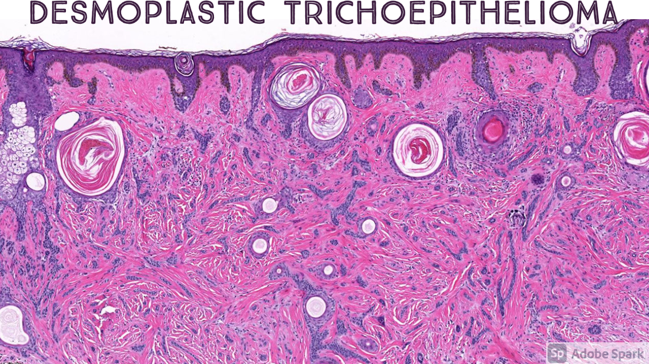
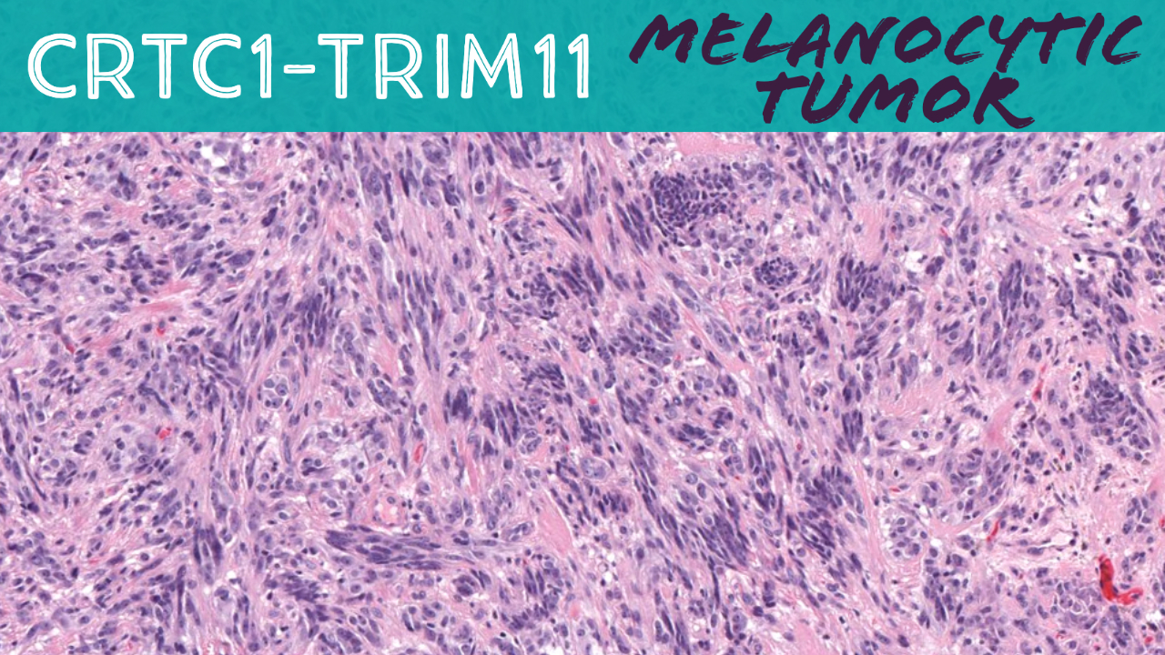
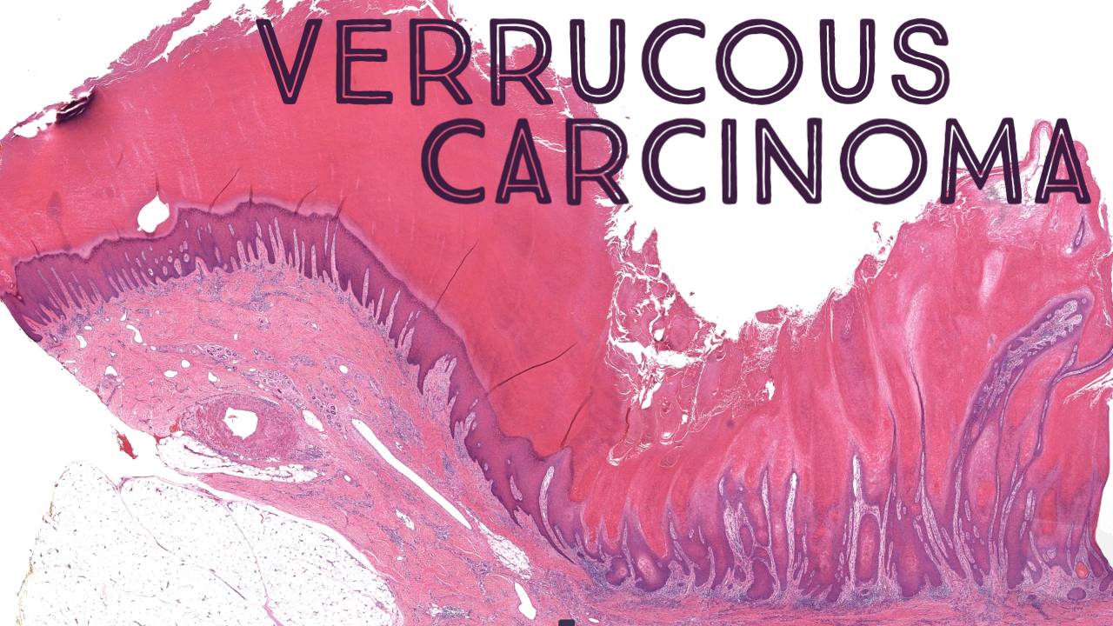
I also divided the 5 hour video into 20 short video clips (one for each individual entity discussed during the course). Some people like long videos, some like short videos. Maximizes views & appeals to different types of learners

Slide 40
Screen recording - techniques
ScreenPal is my favorite app
Cost: $20 USD/year
Records in 1080p or 4k!
Quicktime app on Mac also works great
Many virtual meeting programs like Teams/Zoom/etc offer screenrecording
(but sometimes they have lower resolution)

Slide 41
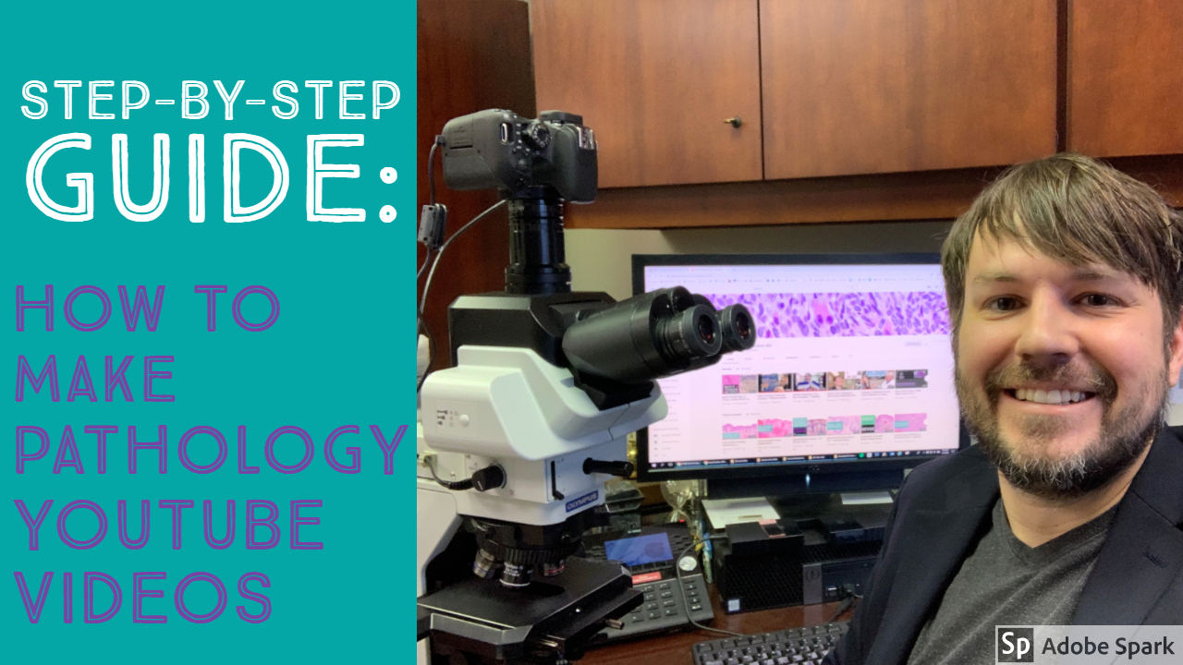
https://kikoxp.com/posts/13945

Slide 42
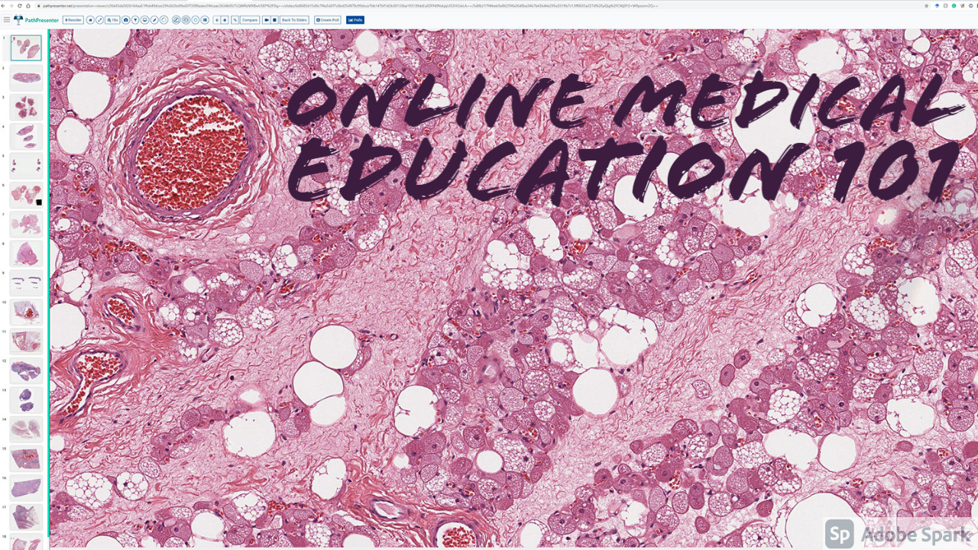
More info on how I make videos and how I share them on my other social media channels to maximize views
https://kikoxp.com/posts/7209

Slide 43
What should you make videos about???
What are you knowledgeable about?
What are you passionate about?
What knowledge gaps are there that you can help fill?
Who is your intended audience?
Patients/members of public? Students? Dermatologists? Other doctors?

Slide 44
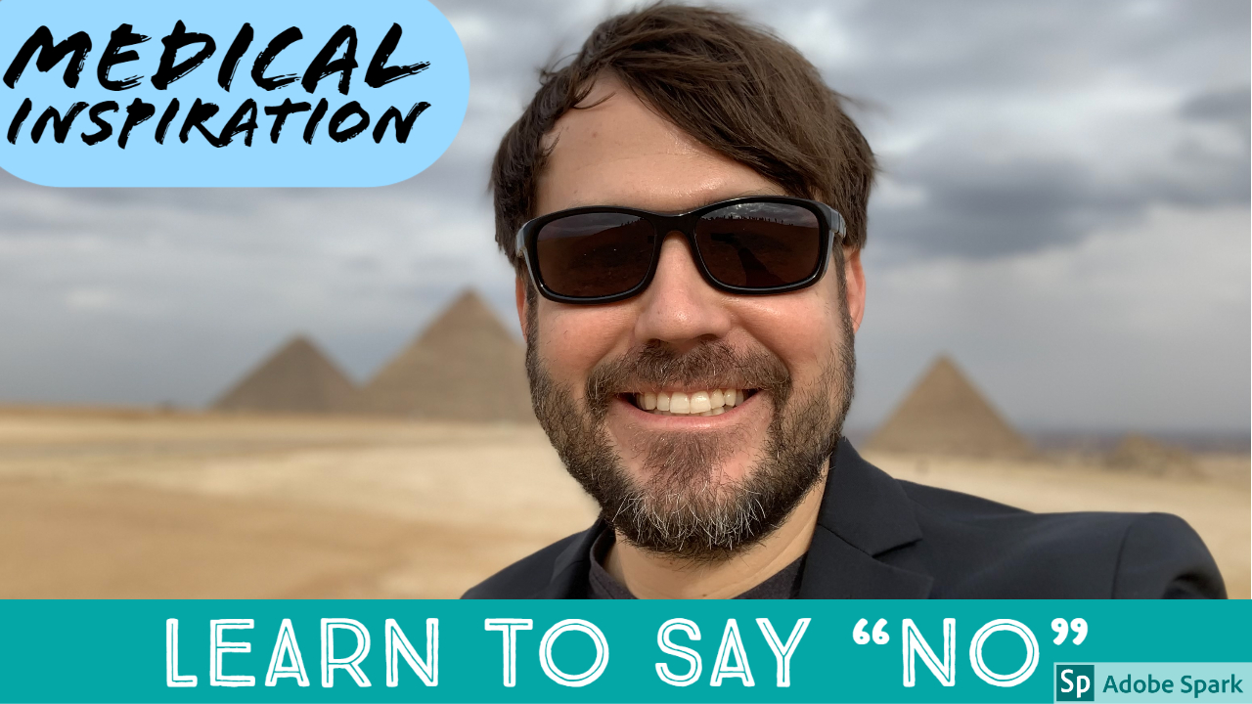
“Perfect is the Enemy of Good”
Don’t let perfectionism stop you from pursuing your dreams and making a positive impact on the world!

Slide 45
Survey (2016)
Surveyed my followers for feedback re: my social media teaching
(I actually included results in my application packet for promotion to Associate Professor with tenure)
JMGardnerMD@gmail.com
Social Media 101: www.bit.ly/1Aaxuiz
@JMGardnerMD

Slide 46
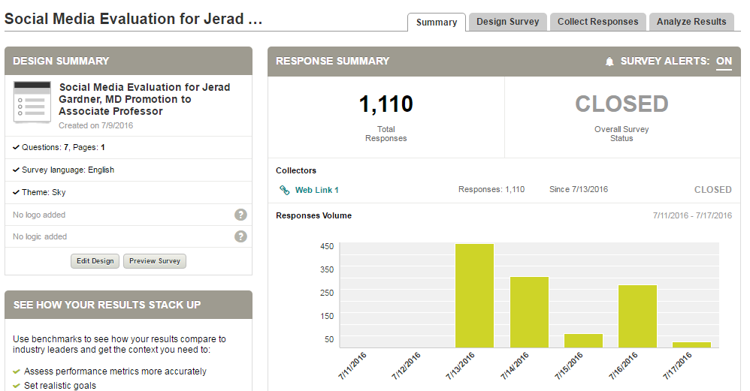
1110 responses from 85 countries in 4.5 days
Social Media 101: https://kikoxp.com/posts/15217
@JMGardnerMD

Slide 47
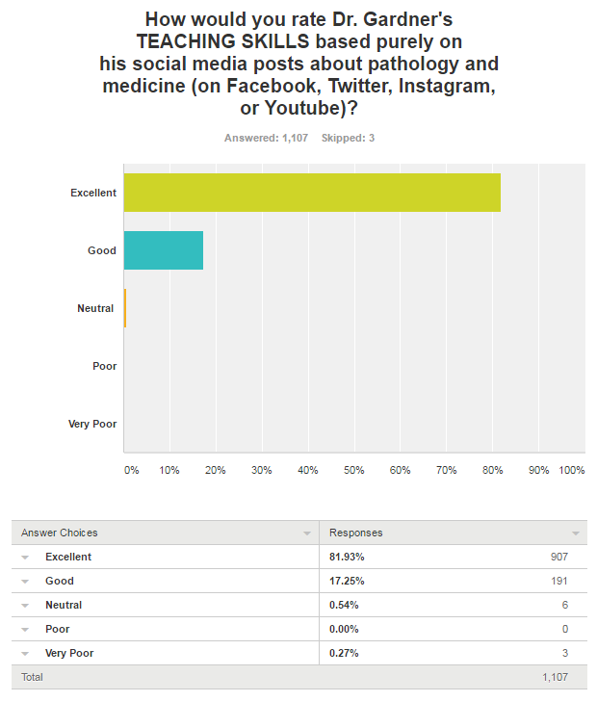
99%
@JMGardnerMD

Slide 48
Impact is more important than metrics

Slide 49
@JMGardnerMD

Slide 50
89% of doctors agreed that my social media posts helped them care for REAL LIFE patients (n=681/762)
@JMGardnerMD
Notes:
681/762= 89% of doctors

Slide 51
Whatever we are trying to accomplish in our careers…
Social media can help us do it bigger, better, faster.

Slide 53
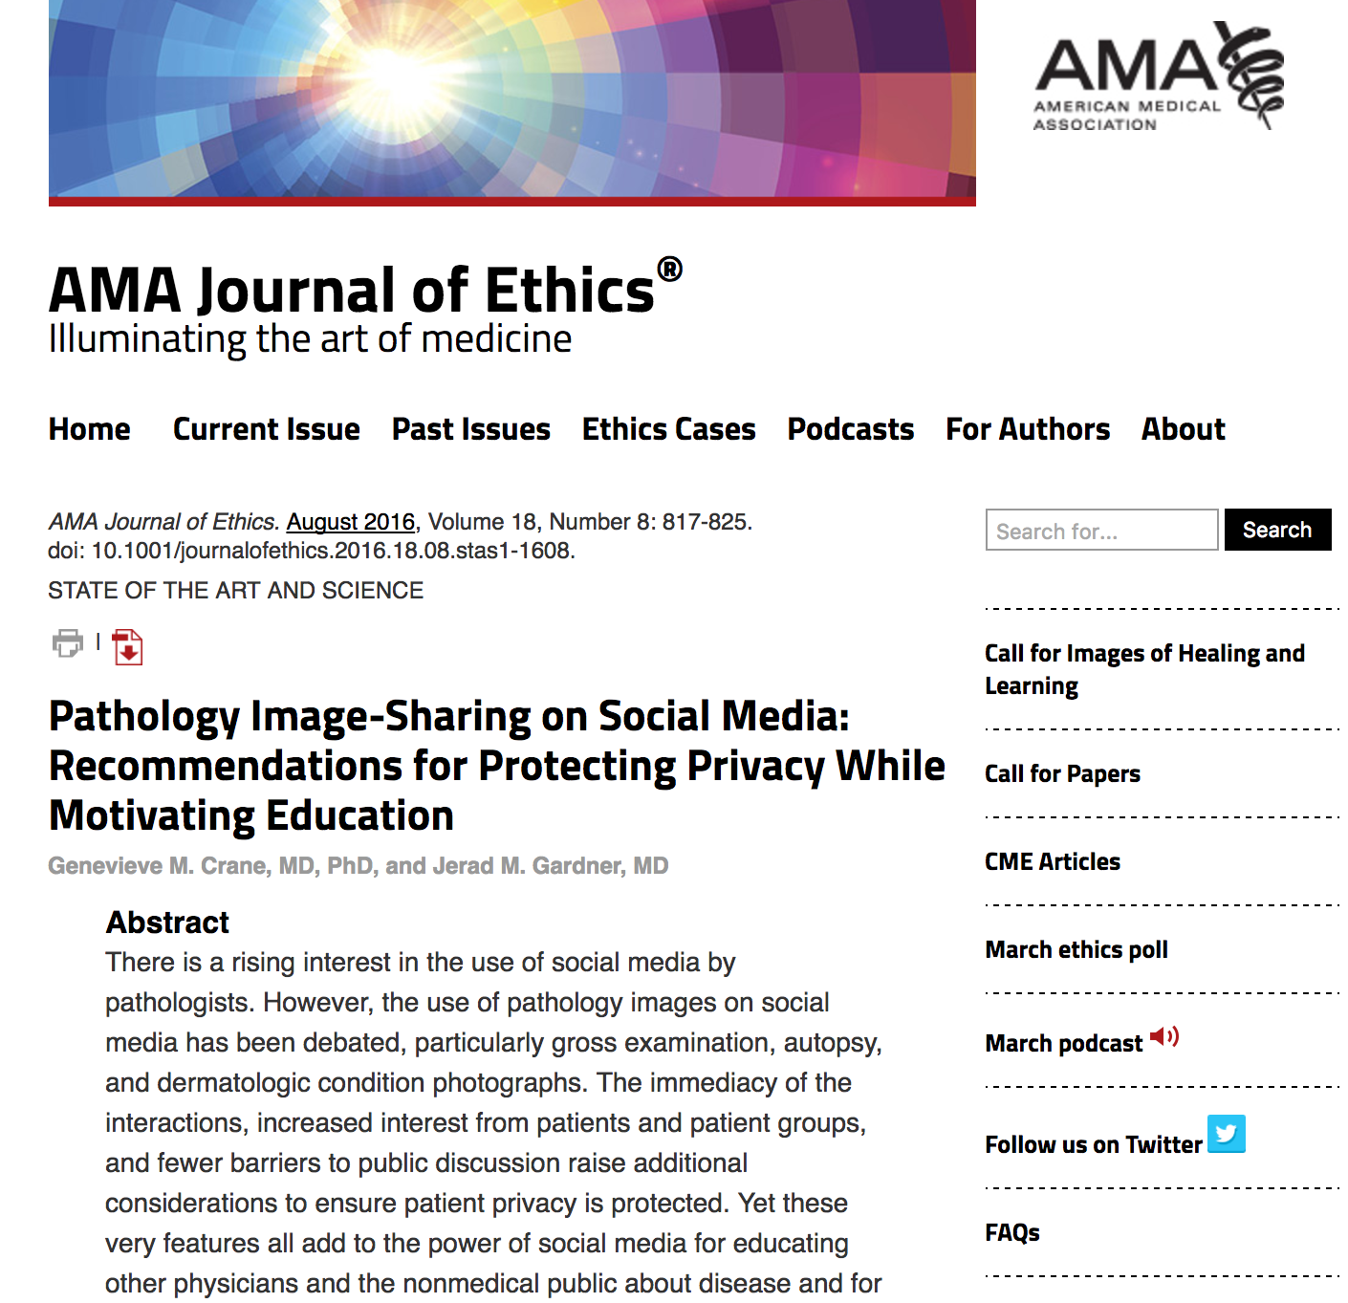

Slide 54
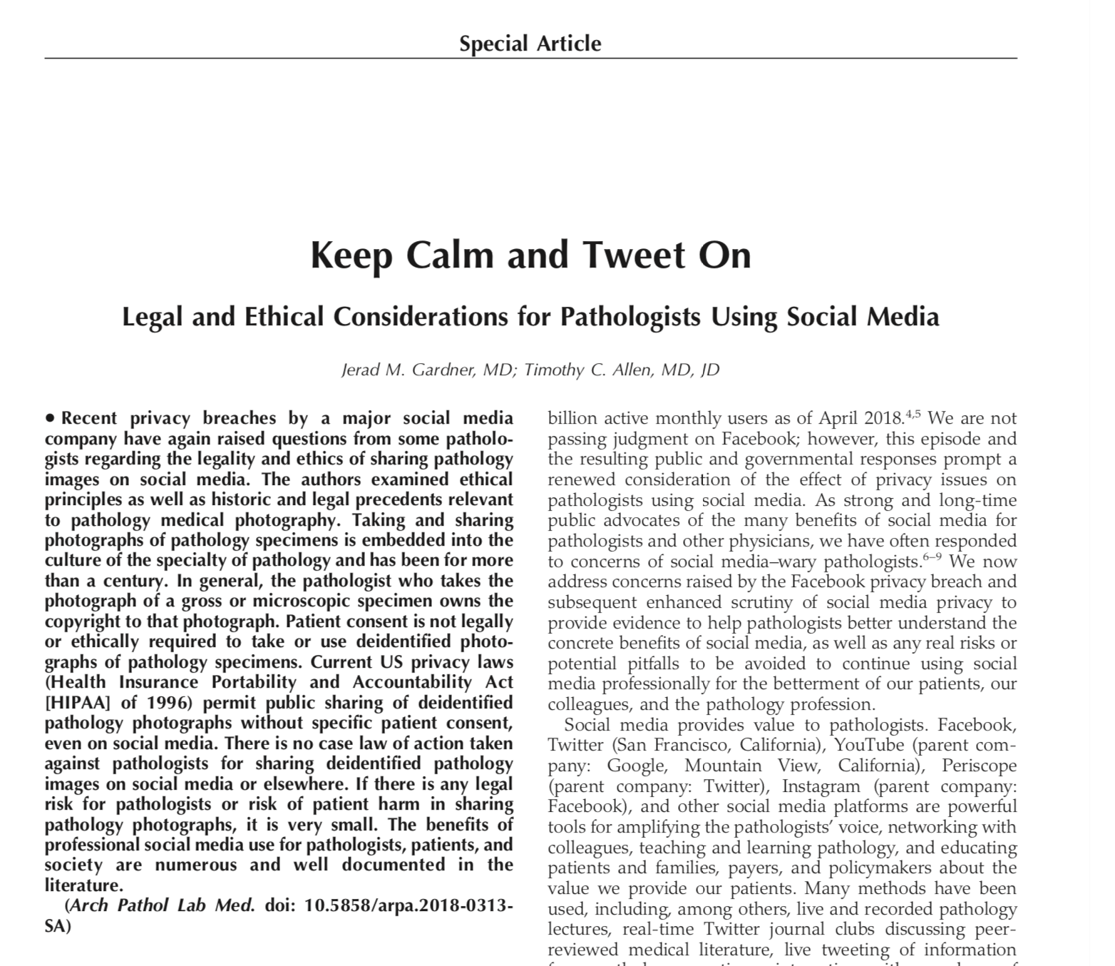

Slide 55
Summary
It is legally (at least in USA & UK) and ethically OK to share deidentified gross or microscopic pathology pics
No legal action taken against anyone for sharing deidentified medical pics for educational purposes to our knowledge
But you do need to know and respect your employer’s rules
Social Media 101: https://kikoxp.com/posts/15217
@JMGardnerMD

